Slide 1
Built LEED Training

Slide 2
Objectives of this Training
Understand LEED and the value of the LEED certification
Gain awareness of the current LEED rating tools and how they impact your work
Learn how to determine compliant products and materials through examples

Slide 3
Why LEED?
LEED is the world’s leading green building project and performance management system, delivering a comprehensive framework for green building design, construction, operations and performance
The rigorous focus on material selection, human comfort, air quality and human health features of a building rightly prioritizes the most important asset of the building: human beings
The specific focus on social equity ensures that buildings are not considered in isolation of their communities but prioritize access and inclusiveness for all

Slide 5
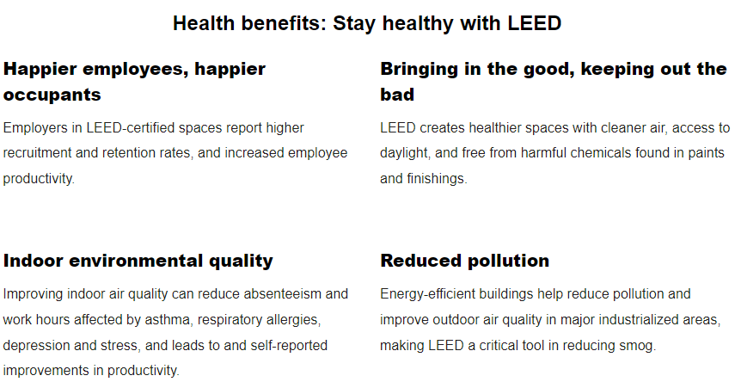

Slide 6
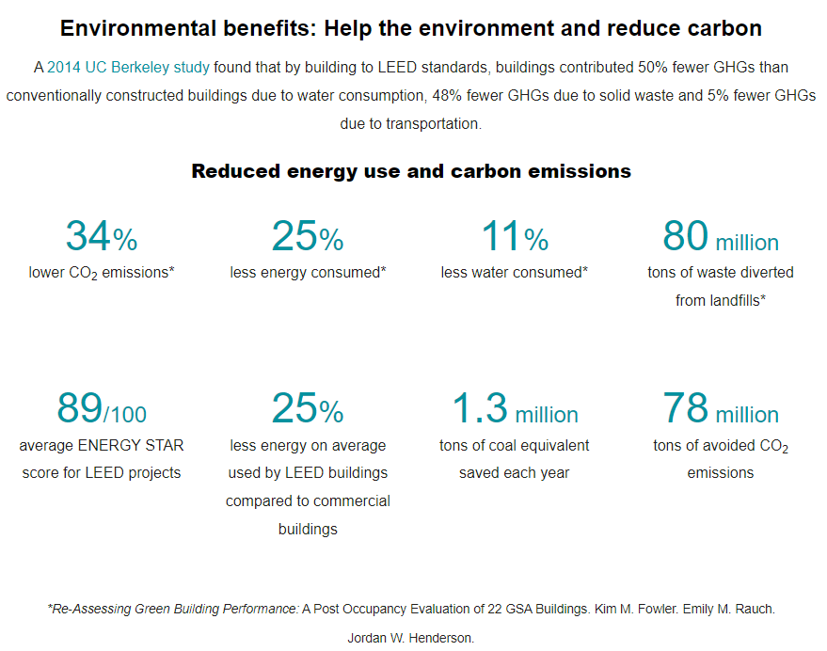

Slide 7
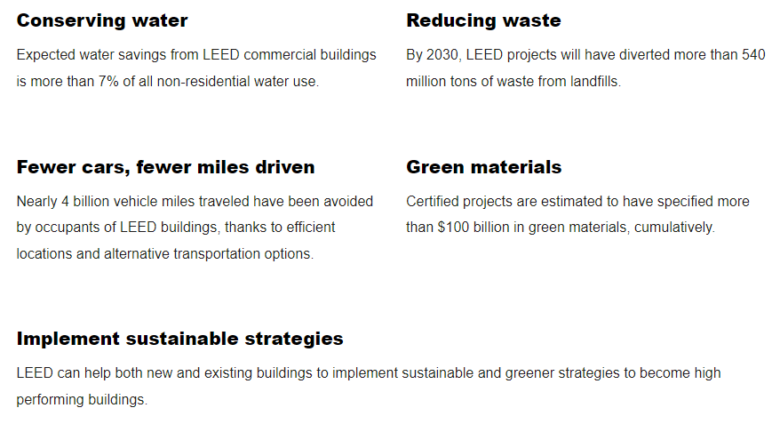

Slide 8
LEED System Goals

Slide 9
LEED Rating Tools & Certification Levels

Slide 10
LEED Categories

Slide 11
Subbies Responsibility for LEED
Understand the project LEED pathway and what it signs you up to deliver
Understand rating tool requirements, specifically material compliance
Ensure documentation collection systems are set up from the start
Set up back-to-back contracts to ensure compliance by your subbies

Slide 12
Credits Related to you – Products & Materials
You must provide:
An upfront materials forecast and compliance evidence for Built approval prior to purchase and use on site
Monthly material usage tracking sheets (with monthly claims) to ensure that non-compliant materials are kept within their allowance benchmarks
A confirmation letter and close out evidence (certificates, invoices) once your scope is complete

Slide 13
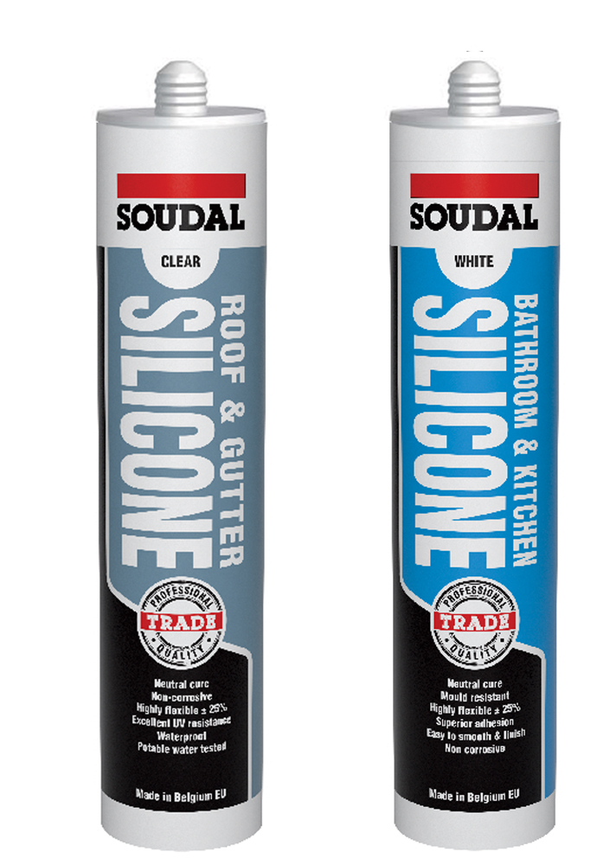
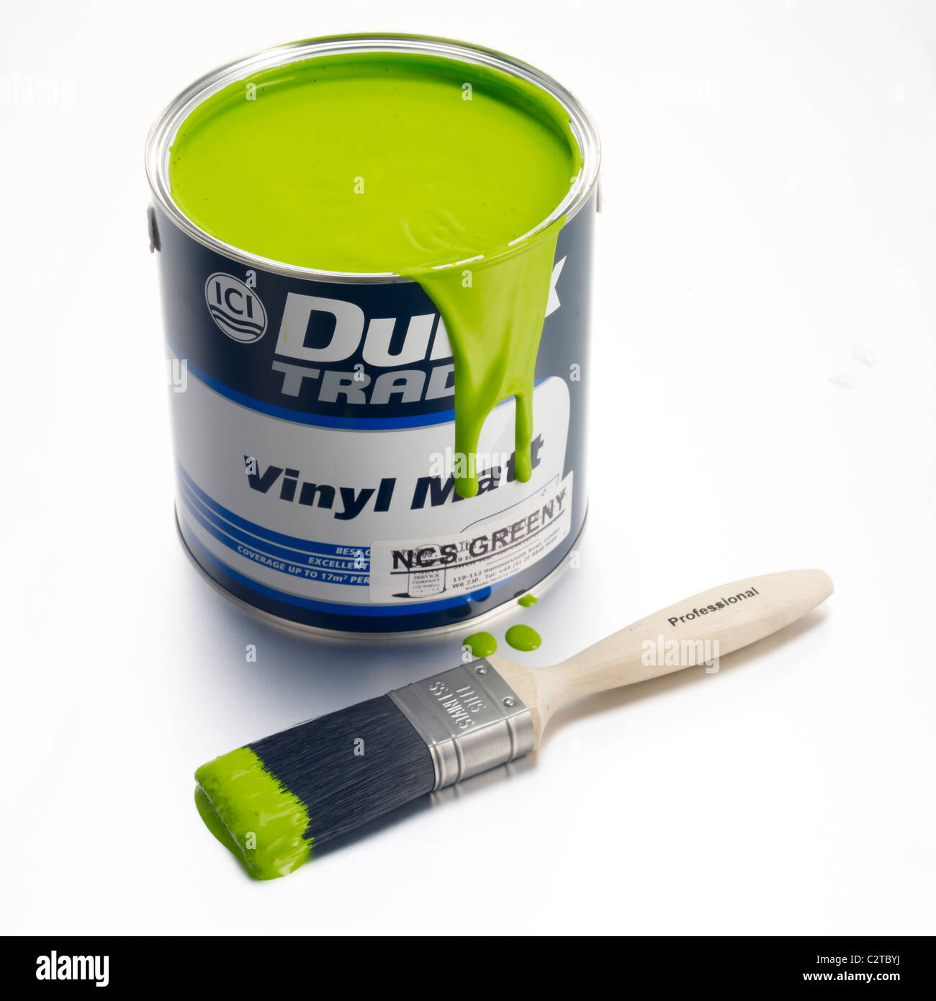
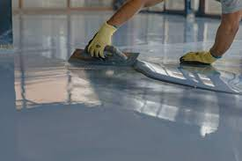
VOC Restrictions
Paints, Coatings, Adhesives & Sealants
Compliant certification methods:
All products must be tested to meet methods and thresholds established in 1 of the following standards/regulations for VOC content:
SCAQMD Rule 1168 (Adhesives and Sealants, 2017)
2019 CARB SCM for Architectural Coatings
European Decopaint Directive (2004/42/EC)
Hong Kong Air pollution control (VOC) Regulation for regulated architectural paints (January 2010) and adhesives and regulated sealants (April 2012)
Canadian VOC Concentration Limits for Architectural Coatings (SOR/2009-264)
Free of solvents, as defined in TRGS 610 (January 2011)
At least 75% of products are tested to meet testing methods and thresholds established in 1 of the following standards/regulations for VOC emissions:
California Department of Public Health (CDPH) Standard Method v1.2-2017
AgBB.9

Slide 14
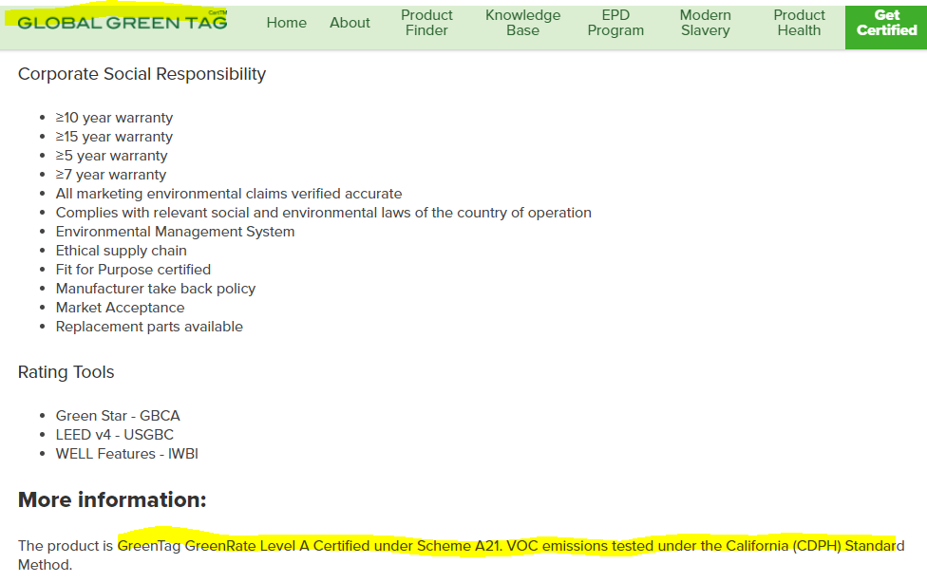
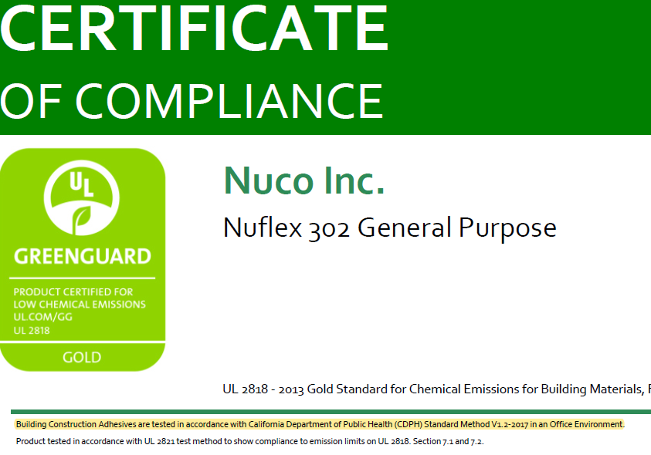
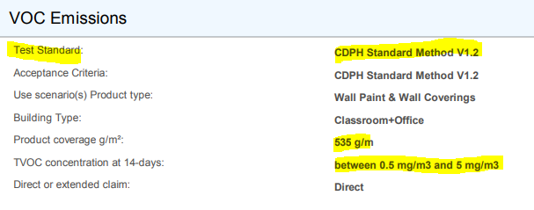
VOC Restrictions
Paints, Coatings, Adhesives & Sealants

Slide 15
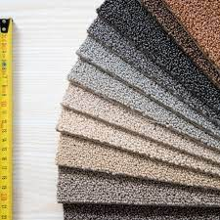
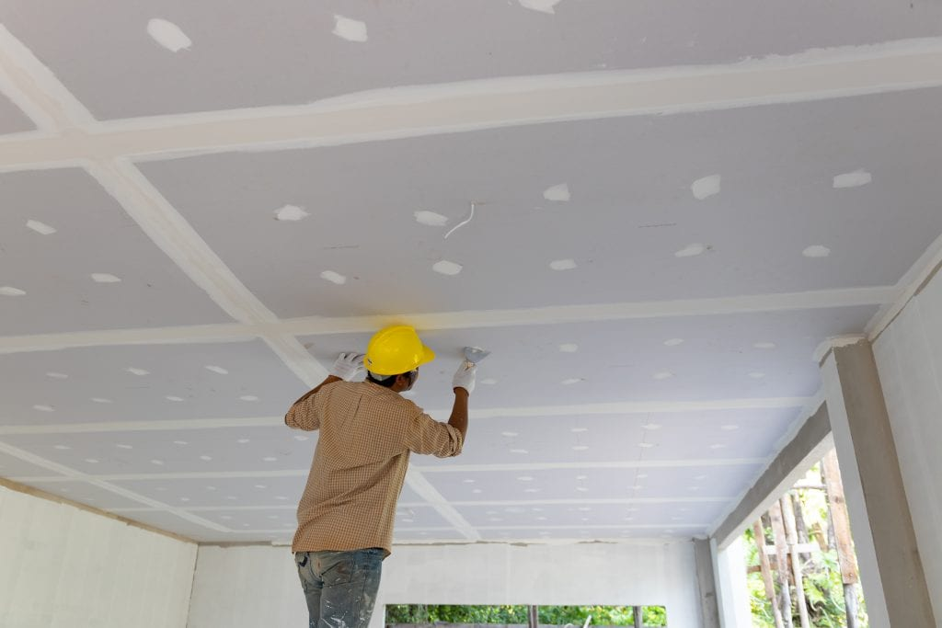
VOC Restrictions
Flooring, Ceilings & Wall Panels
Compliant certification methods:
Products must be tested per methods and meet VOC emission thresholds established in 1 of the following:
California Department of Public Health (CDPH) Standard Method v1.2-2017
Tested according to EN 16516:2017 and complies with the LCI values from Table 1 of the German AgBB Testing and Evaluation Scheme (2015)
Or salvaged or reused materials

Slide 16
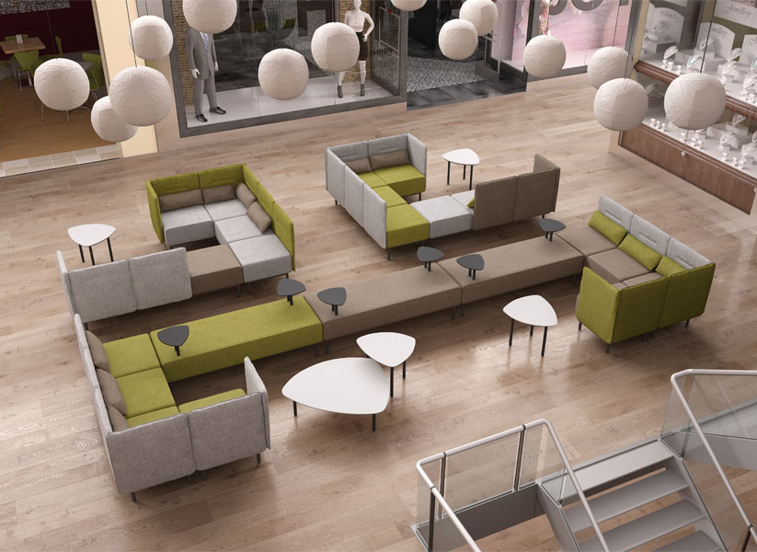
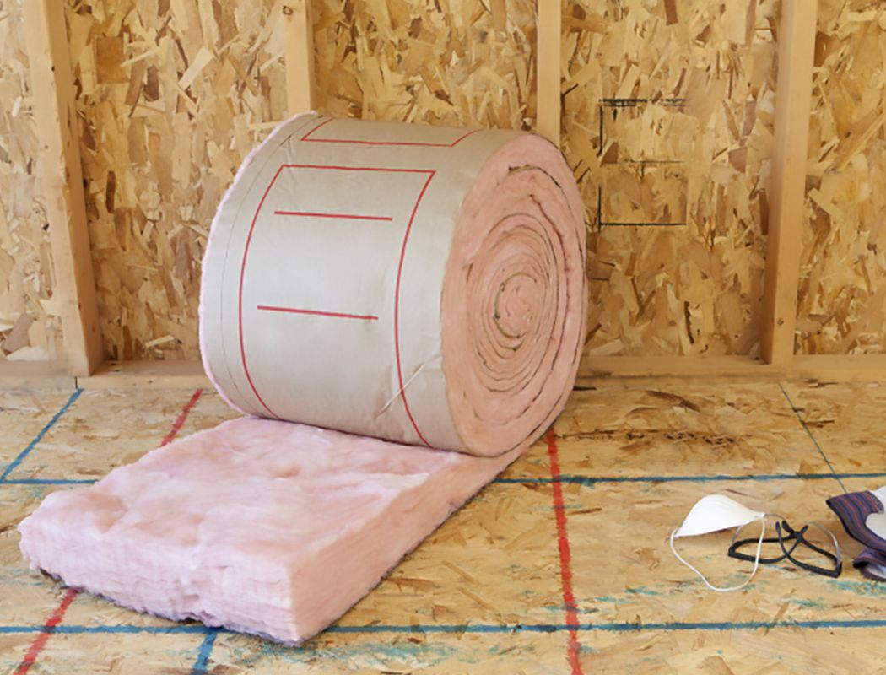
VOC Restrictions
Furniture & Insulation
Compliant certification methods:
Products must be tested per methods and meet VOC emission thresholds established in 1 of the following:
California Department of Public Health (CDPH) Standard Method v1.2-2017
Tested according to EN 16516:2017 and complies with the LCI values from Table 1 of the German AgBB Testing and Evaluation Scheme (2015)
Or salvaged or reused materials

Slide 17
VOC Restrictions
Composite Wood
Compliant certification methods:
Products must be tested per methods and meet VOC Formaldehyde thresholds established in 1 of the following:
EPA TSCA Title VI or California Air Resources Board (CARB) ATCM
EN 717-1:2014 for formaldehyde emissions and complies with emissions class E1.

