Slide 1
Understanding Green Star Design & As Built
For Subcontractors

Slide 2
Objective of this training
Gain deeper knowledge of Green Star Certification and its value to the project
Understand how Green Star applies to you and your work
Understand how to ensure your teams’ work is compliant
Learn the process for confirming your products and materials are compliant with our sustainability team

Slide 3
Sustainability and the Construction Industry
The construction of new buildings is responsible for:
Producing 40% of Greenhouse Gas emissions globally
Consuming 32% of the world’s natural resources
Consuming 40% of the world’s energy
Producing 40% of all landfill
We are in a privileged position to be able to make changes to the way we build that result in huge and valuable impacts to the environment.

Slide 4
Why Certify?
Green Star is a clear guide on how to achieve excellence in sustainable outcomes, providing practical steps to implement.
Project sustainability ratings are also highly valued by the building developers, investors, owners, and tenants.
Building owners
can confidently publish their sustainability claims knowing everything is verified
Owners can communicate sustainability attributes to prospective investors and tenants
Sustainable buildings have been proven to increase physical and mental health, and productivity
Sustainable buildings use over 50% less energy and water, which reduces operating costs

Slide 5
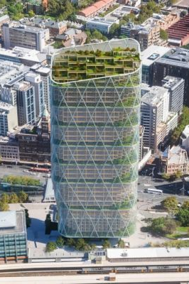
What is Green Star?
Green Star is Australia’s most widely renowned and highly regarded sustainability certification for construction.
Green Star projects:
Reduce carbon emissions and embodied carbon
Enhance the physical and mental health of the tenants
Add value to the local community
Are designed for the future
Contribute to a more sustainable and circular economy

Slide 6
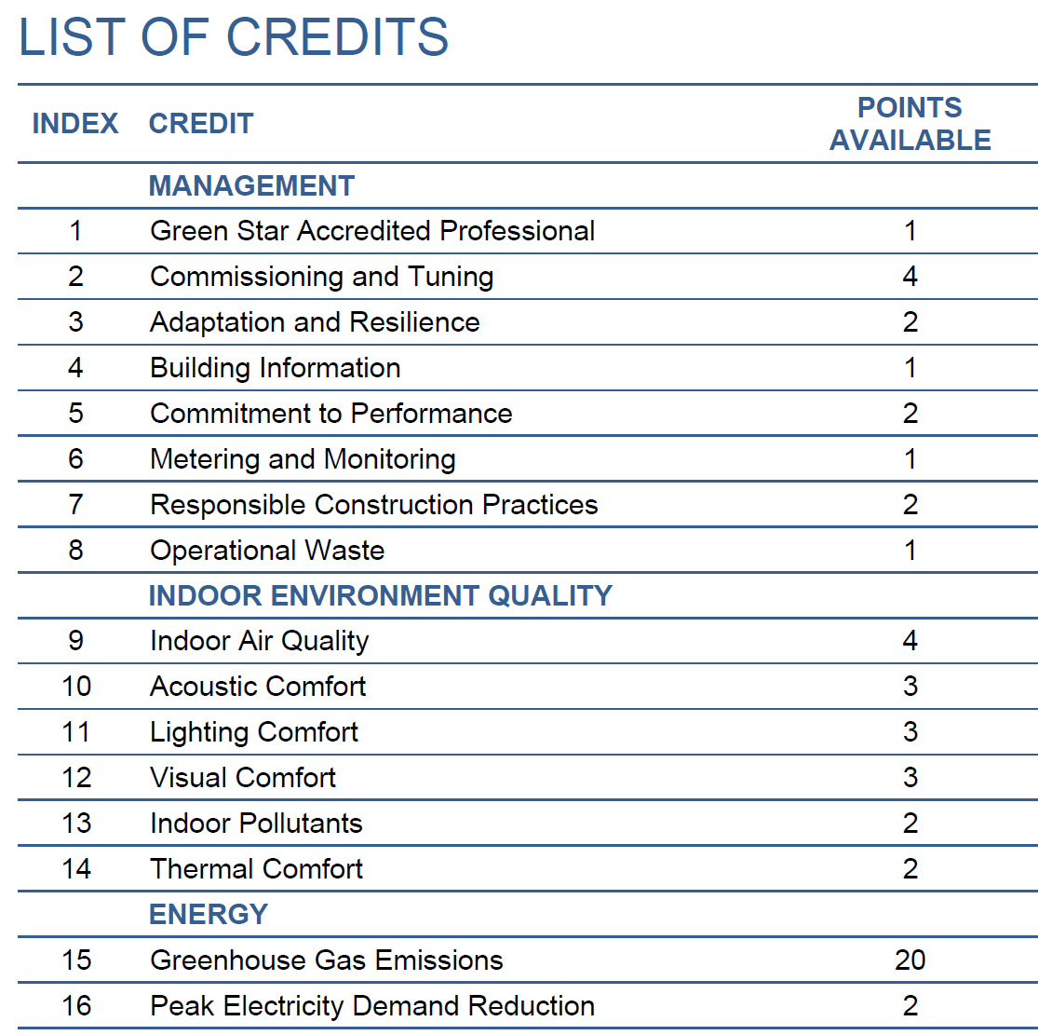
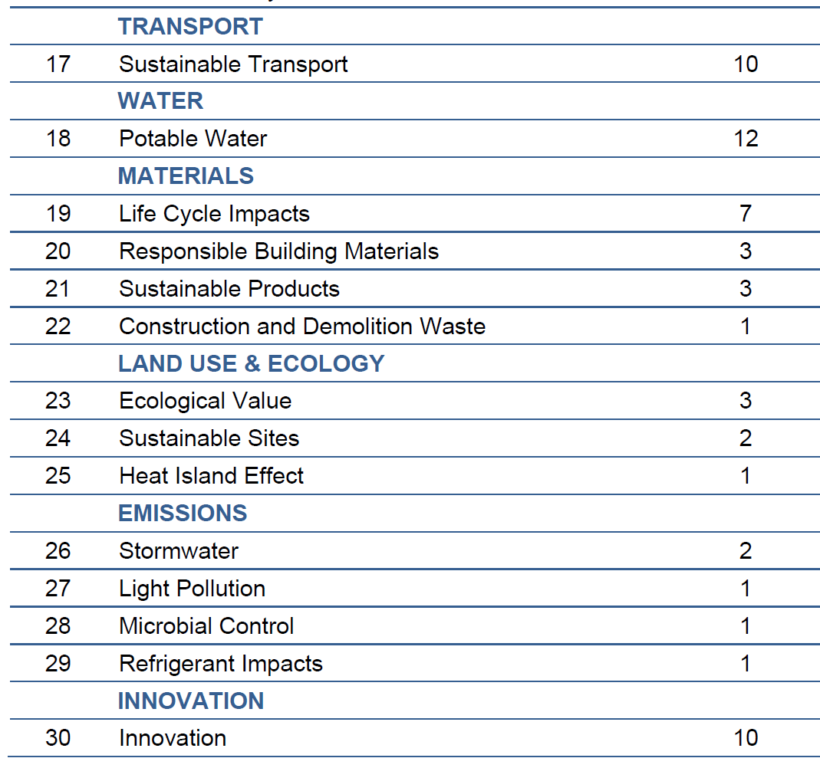
Green Star Design & As Built
(older projects commencing prior to 2023)
The certification is broken up into 9 categories encompassing all elements of the building.
Within these categories, you can see there are many ‘credits’ we can target, each with a point value. There are 100 points available + 10 innovation points.
4 Stars = 15 points
5 Stars = 35 points
6 stars = 70 points
e.g. specific to the project
Targeting 6 Star – attempting 85 points

Slide 7
Your responsibilities as a contractor on a Green Star project
Review the Green Star pathway for the project and understand what it signs you up to deliver
Communicate with the Built sustainability team if you have any questions or concerns
Understand material compliance and remember to submit your monthly material tracking to Built to be reviewed and confirmed
(more detail on this later in this training)
Ensure documentation collection systems are set up from the start of the project
Set up back-to-back contracts to ensure compliance by your subbies

Slide 8
Compliant Products and Materials
To ensure we are only using compliant products that meet the Green Star standards, Built must approve all products in the outlined categories.
The process for material tracking requires the following:
Submit a ‘materials forecast’ before purchasing any material, including required evidence
Once your materials have been approved, you can purchase and use the materials
Submit monthly ‘materials tracking’ confirming the materials that have been used each month – this gives you the opportunity to put forward new materials that were not in the forecast. Invoices are also collected as proof of purchase
A final Confirmation Letter is to be signed and all related evidence submitted as part of our Green Star evidence

Slide 9
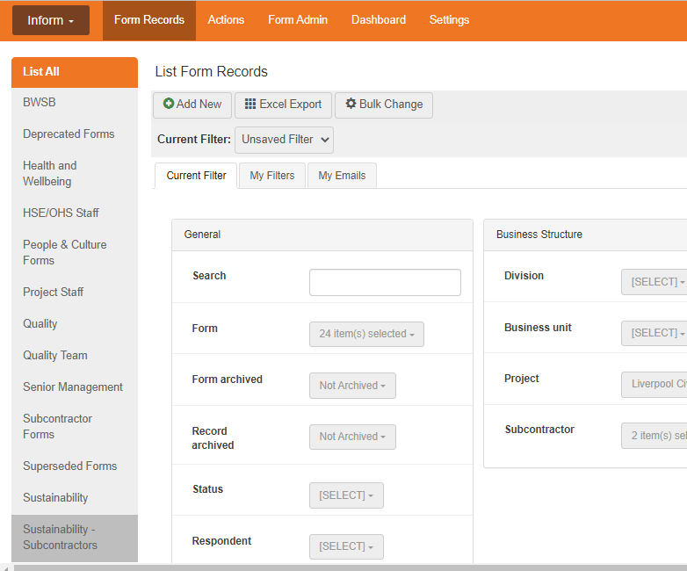
Lucidity
Lucidity link: Lucidity :: Inform (luciditysoftware.com.au)
Understanding Green Star

Slide 10
Toxins: VOCs
What are VOCs? Volatile organic compounds - chemicals that are emitted as gases from certain materials
Noticeable as a strong smell commonly emitted by glues and paints, which can result in negative health effects
We must track carpets, sealants adhesives and paints applied onsite within the building envelope (Excluded: Outside or carpark applications, temp works, pipe cements)

Slide 11
Toxins: Formaldehyde
As with VOC’s, formaldehyde is a strong smelling chemical commonly found in the glue used in engineered wood products
We must track MDF, plywood, particleboard, LVL, HPL, compact laminate, decorative overlaid wood panels (Excluded: timber veneers, formwork, carpark applications)

Slide 12
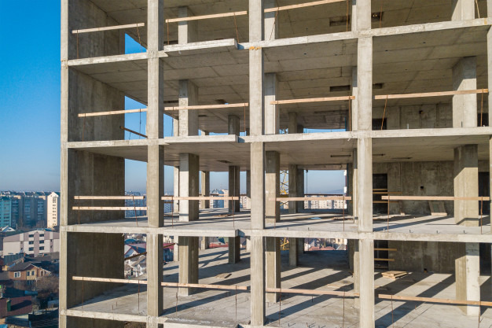
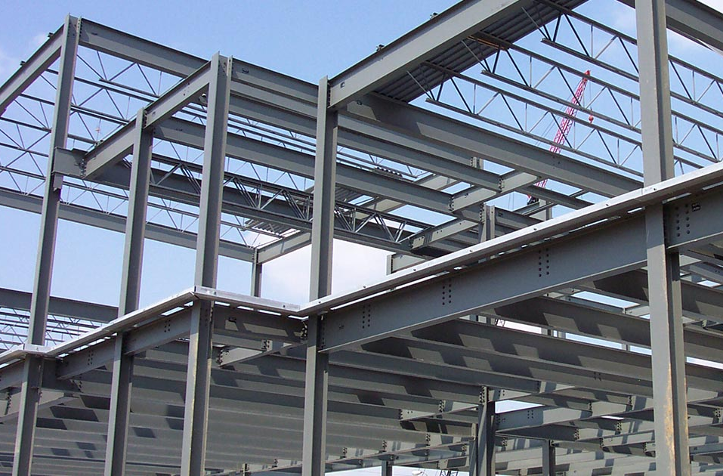
Responsible Materials: Steel
Structural and reinforcing steel must have certification showing it is produced in an environmentally sustainable way.
Concrete Framed Building
= Reinforcing Steel
Steel Framed Building
= Structural Steel

Slide 13
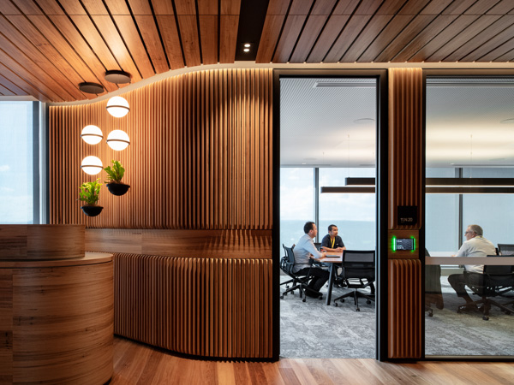
Responsible Materials: Timber
All temporary and permanent uses of timber:
Certified by Responsible Wood or Chain of Custody
OR
Reused / Recycled wood
Proof of Purchases to be collected – must show CoC
Includes:
Formwork, Hoarding, Site Carpentry, Noggings, Joinery, Toilet Partitions, Doors, Lockers

Slide 14
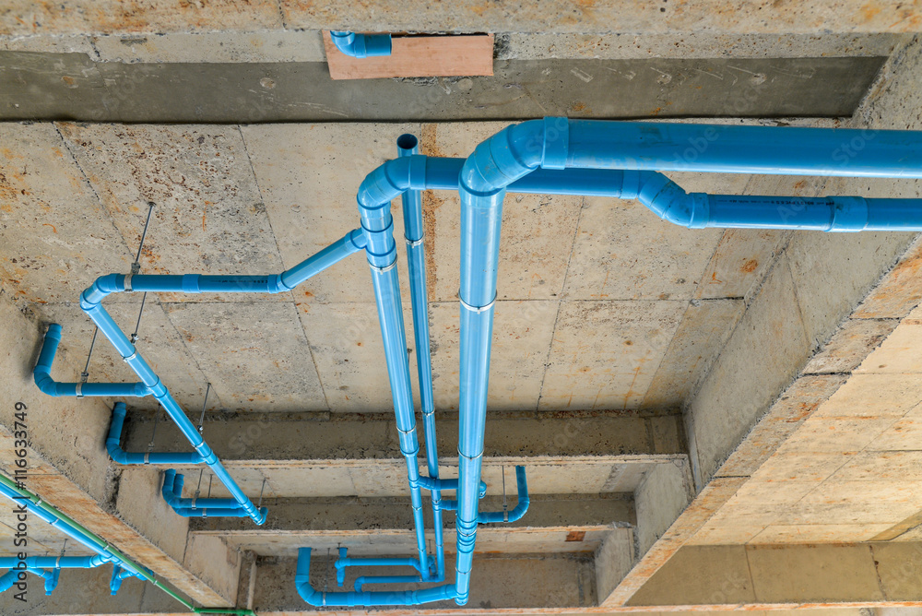
Responsible Materials: PVC
90% by cost of all common uses are either Best Practice PVC or non-PVC
Includes Pipework, Conduit, Fittings, Cabling, Permanent Formwork, Flooring and Blinds
Compliant Certification Methods:
Best Practice PVC Certificate
MSDS showing PVC Free

Slide 15
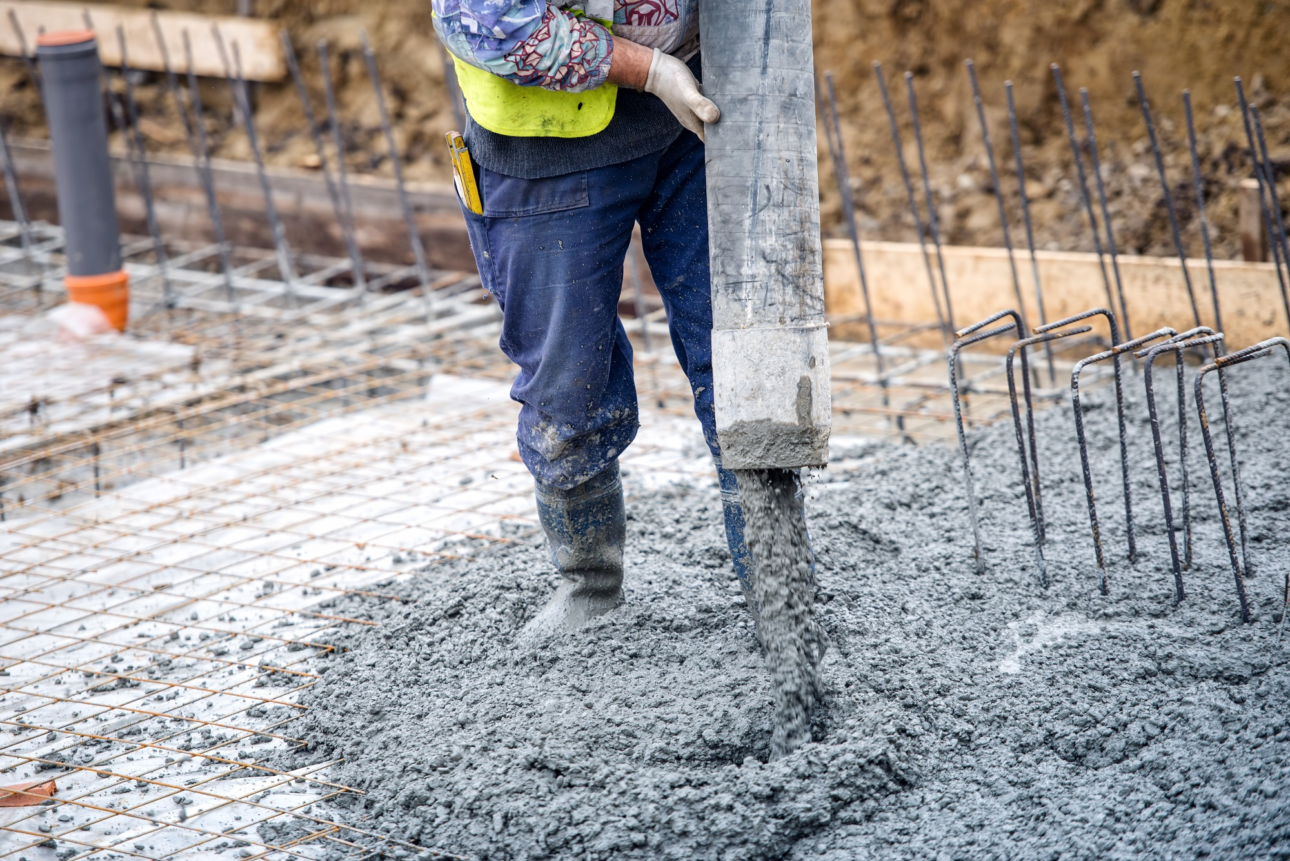
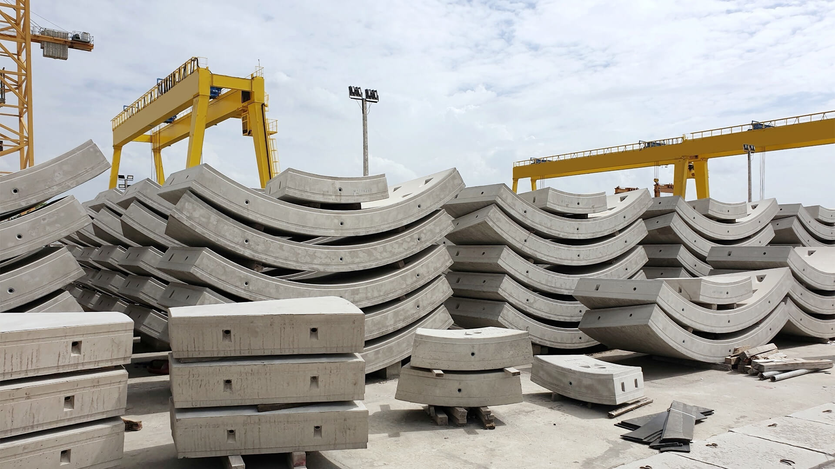
LCA: Concrete
We aim to make changes to the concrete mix so that it is more sustainable when compared to a standard mix
Ways we can improve are:
Reduced Portland cement content
At least 50% captured or reclaimed mix water Aggregate reduction – at least 40% crushed slag aggregate or at least 25% of sand is manufactured sand

Slide 16
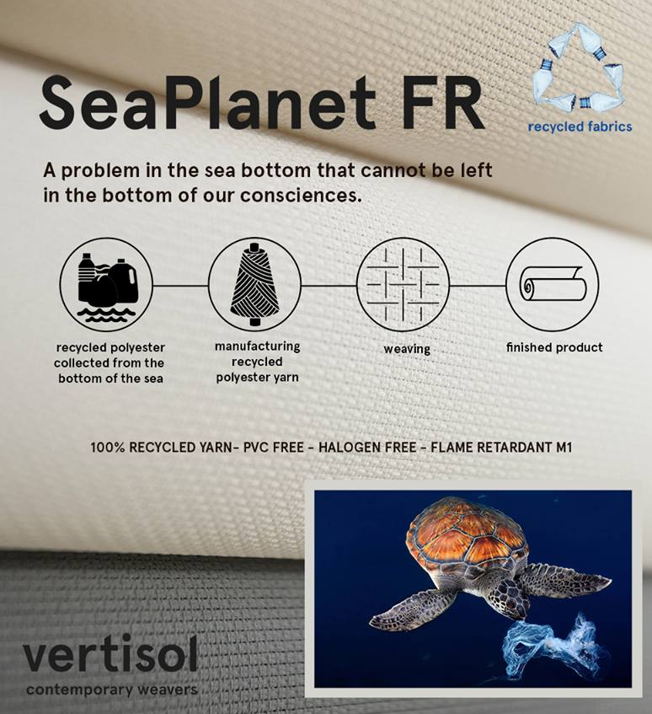
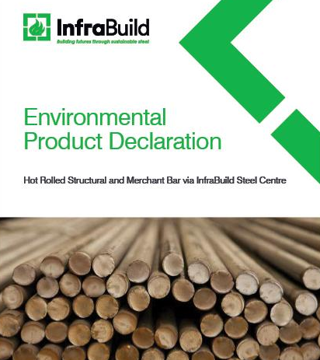
Sustainable Products
Sustainable products are either:
Reused
Recycled
Have a recycled material content
Have an EPD certificate or other recognized certification.
Opportunities to choose a sustainable product option are in: furniture, internal partitions, assemblies, joinery, flooring, wall coverings, ceilings, cladding, masonry, glazing, ceilings, timber, steel, concrete

Slide 17
Sustainability Contacts
Joe Karten | Head of Sustainability and Social Impact | joekarten@built.com.au | +61 431 744 803
Clare Gallagher | National Sustainability Manager | ClareGallagher@built.com.au | +64 27 427 6840
Filomena Beshara | Sustainability Manager | filomenanigro@built.com.au | +61 478 290 250
Jaslyn Brown | Sustainability Engineer | JaslynBrown@built.com.au | +61 438 714 418
Haneen Jaber | Sustainability and Social Impact Lead, Vic | HaneenJaber@built.com.au | +61 429 496 840
Yasmin Blake | Sustainability Coordinator | yasminblake@built.com.au | +61 499 629 094
Pippa Harrison | National Social Impact Manager | pippaharrison@built.com.au | +61 427 118 691

