Slide 1
Introduction to WELL
For Contractors

Slide 2

Learning Objectives
    Understand the WELL Building Standard and the value of the WELL certification
    Identify factors which influence human health and wellbeing
    Gain awareness of the current WELL rating tools and how they impact your work
    Learn how to determine compliant products and materials through examples

Slide 3


Slide 4


Slide 5
Why WELL?
    A WELL Certified project has the potential to add measurable value to the health, well-being, productivity, and happiness of building occupants.
    By placing people at the heart of design, construction, operations and development decisions, we have the ability to add value to real estate assets, generate savings in personnel costs, and enhance the human experience, health and well-being
    Prioritizing WELL also provides the opportunity to stand at the forefront of innovation in the sustainable and healthy building movement
    Physical workplace is one of the top 3 factors affecting performance and job satisfaction
    Personnel costs significantly outweigh the costs for design and construction and maintenance and operations

Slide 6
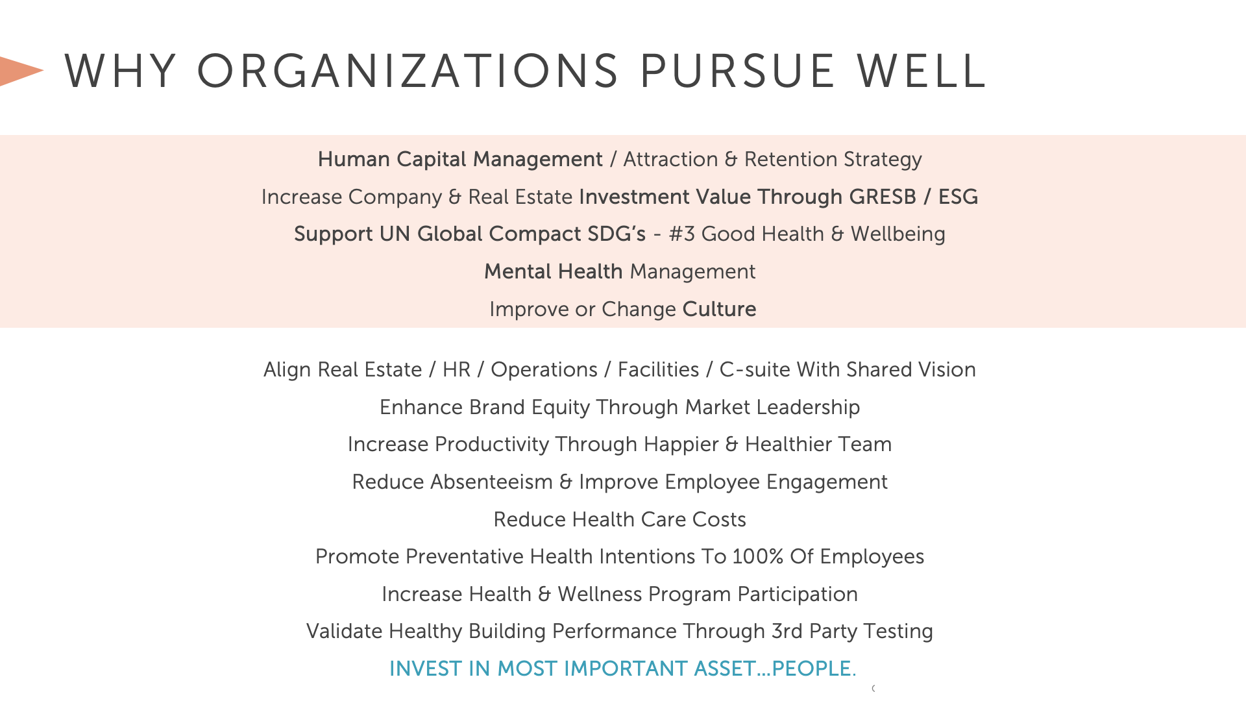

Slide 7
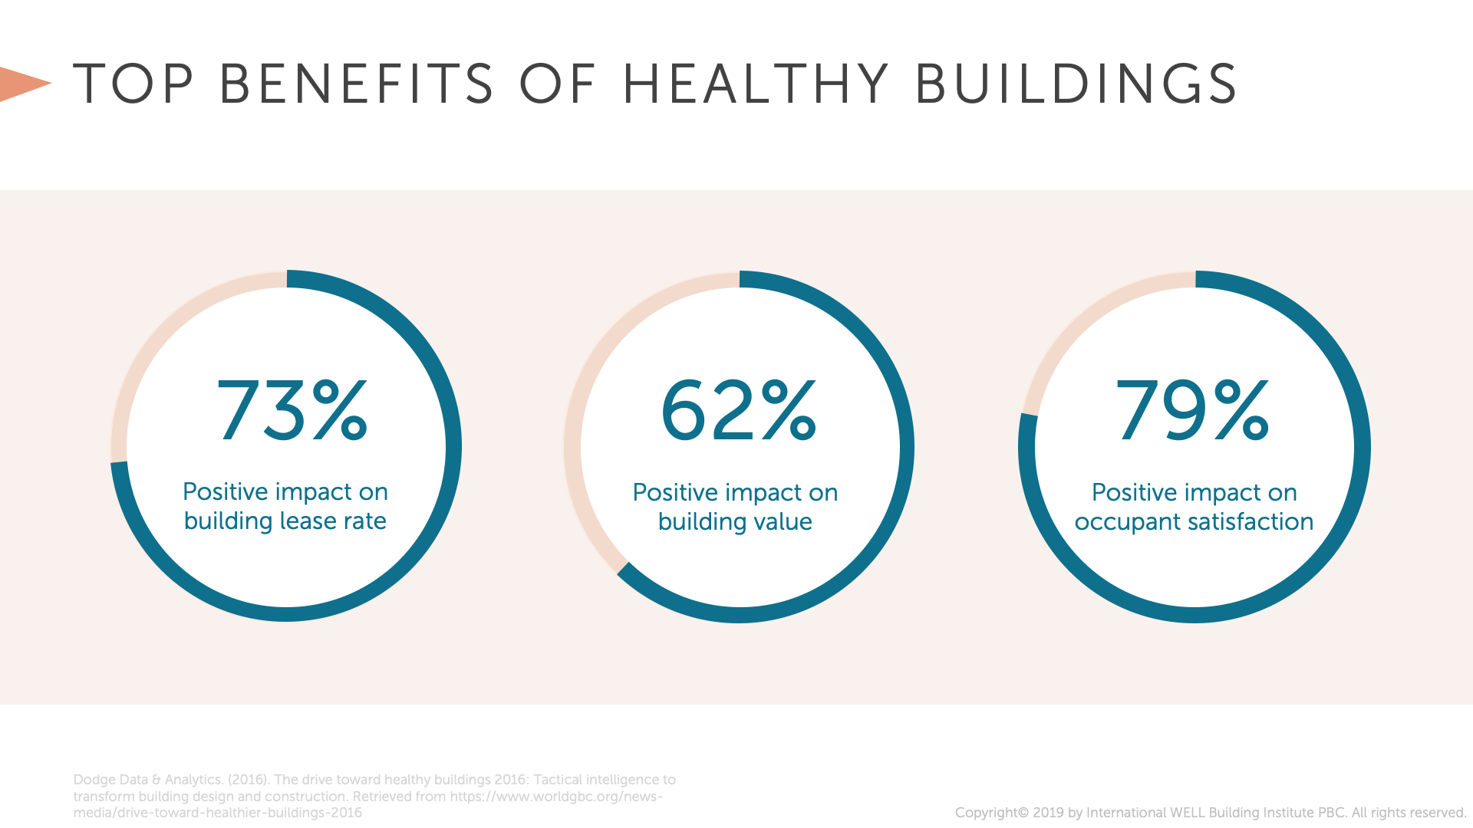

Slide 8
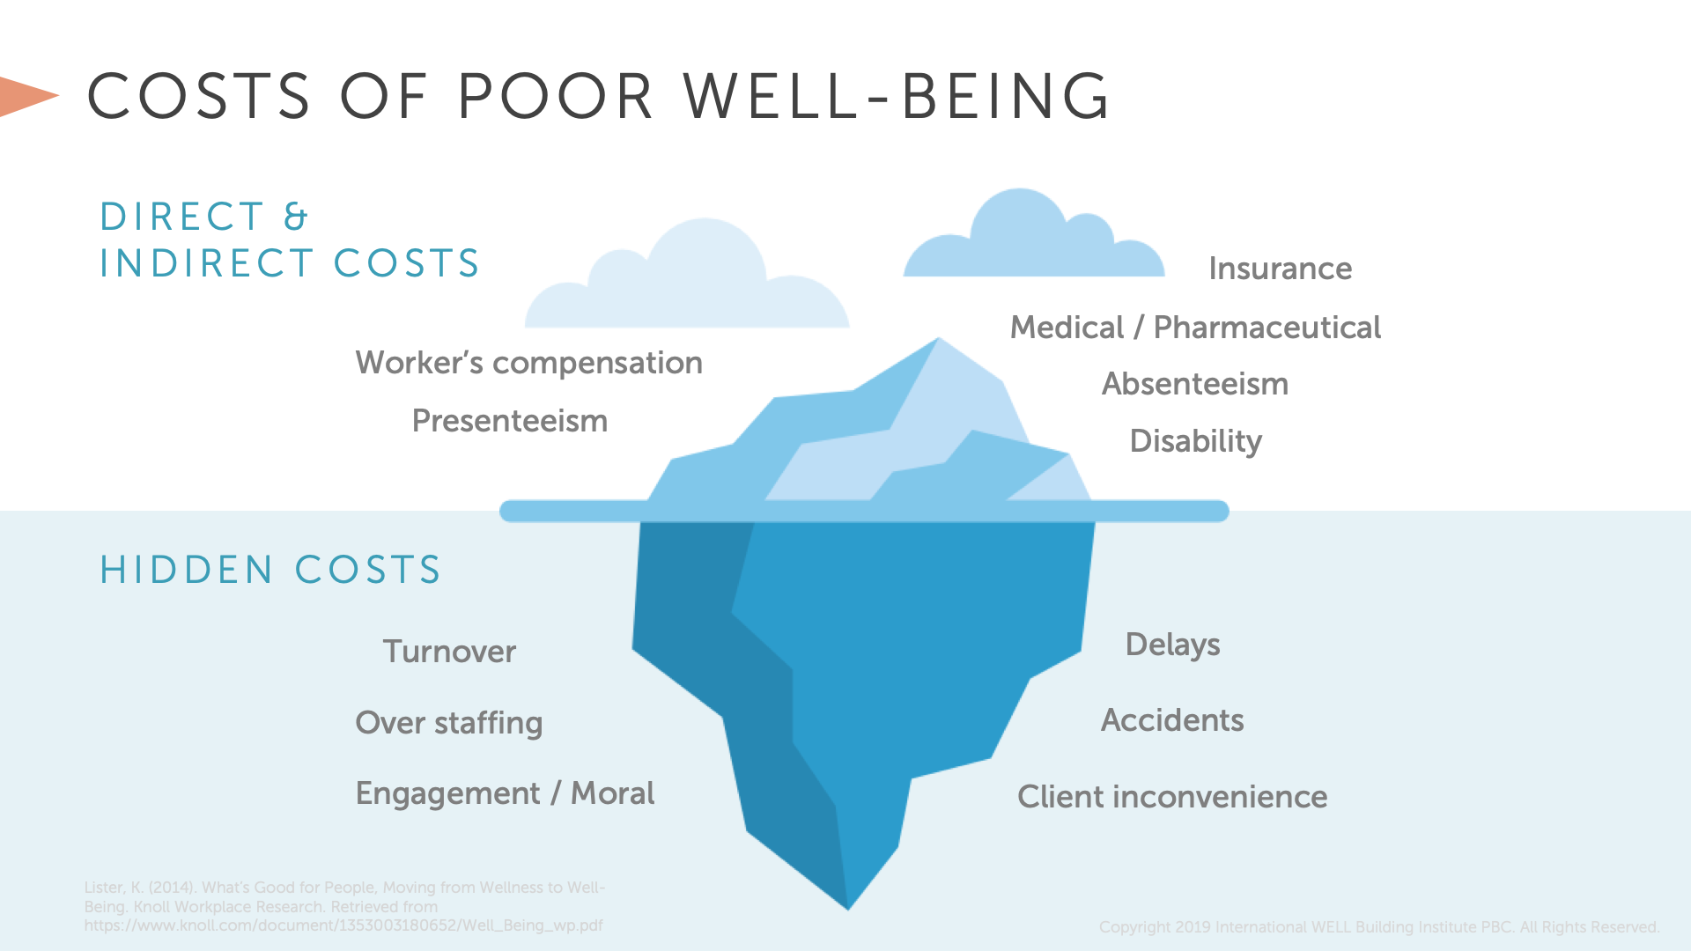

Slide 9
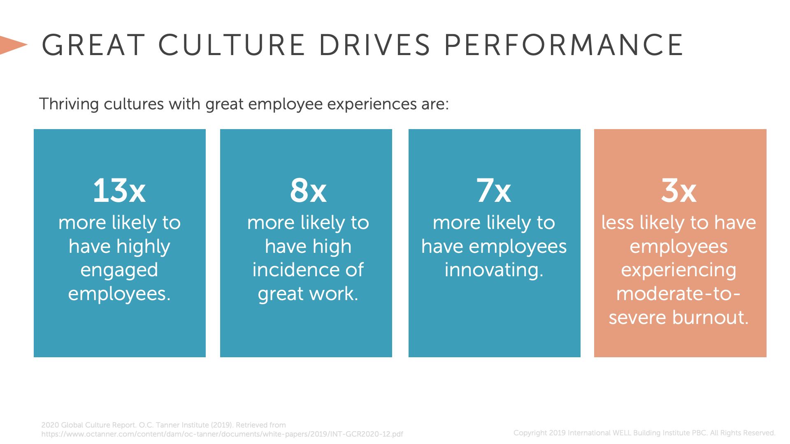

Slide 10
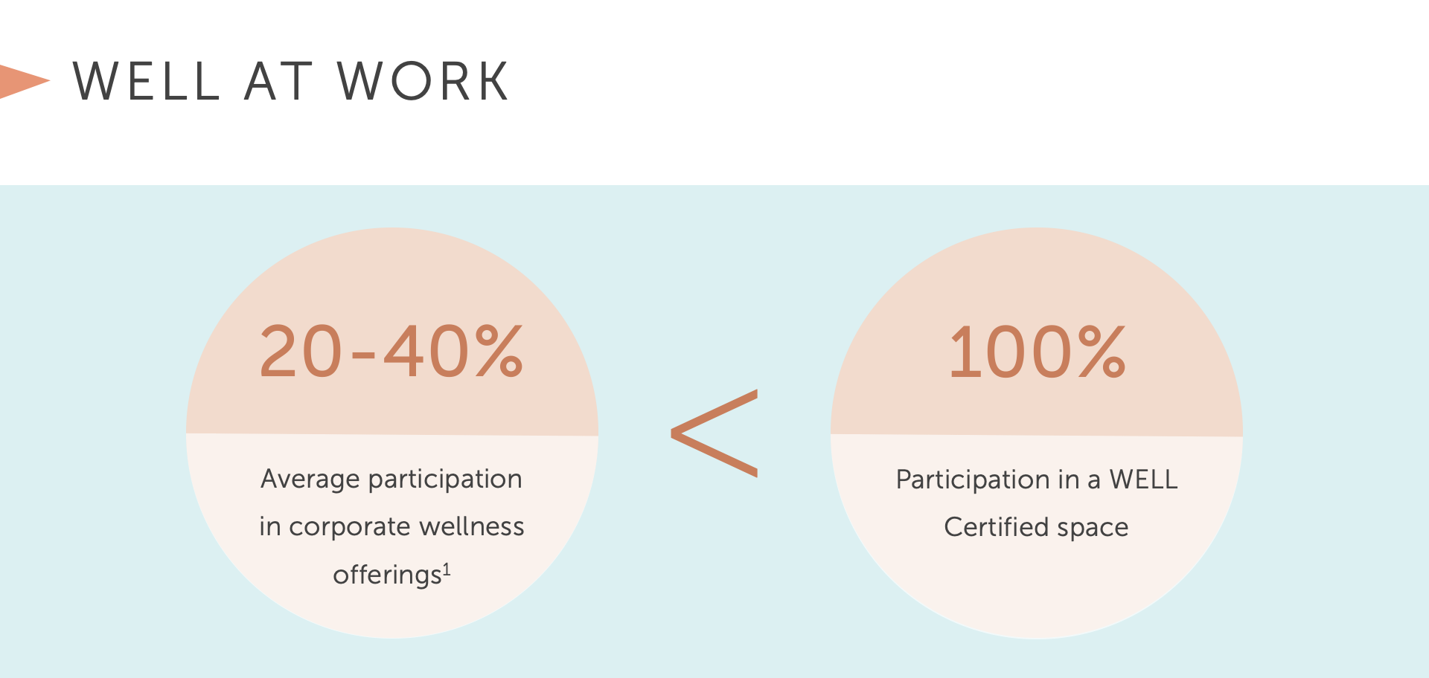

Australian Government Comcare, 2016. Benefits to Business: The Evidence for Investing in Worker Health and Wellbeing. https://www.comcare.gov.au/__data/assets/pdf_file/0006/99303/Benefits_to_business_the_evidence_for_investing_in_worker_health_and_wellbeing_PDF,_89.4_KB.pdf Accessed November 1, 2017.
Copyright© 2017 by International WELL Building Institute PBC. All rights reserved.
Economic return of worksite health promotion programs found, on average, programs save AU$5.81 for every AU$1 invested in employee health and wellbeing.¹

Slide 11


Slide 12
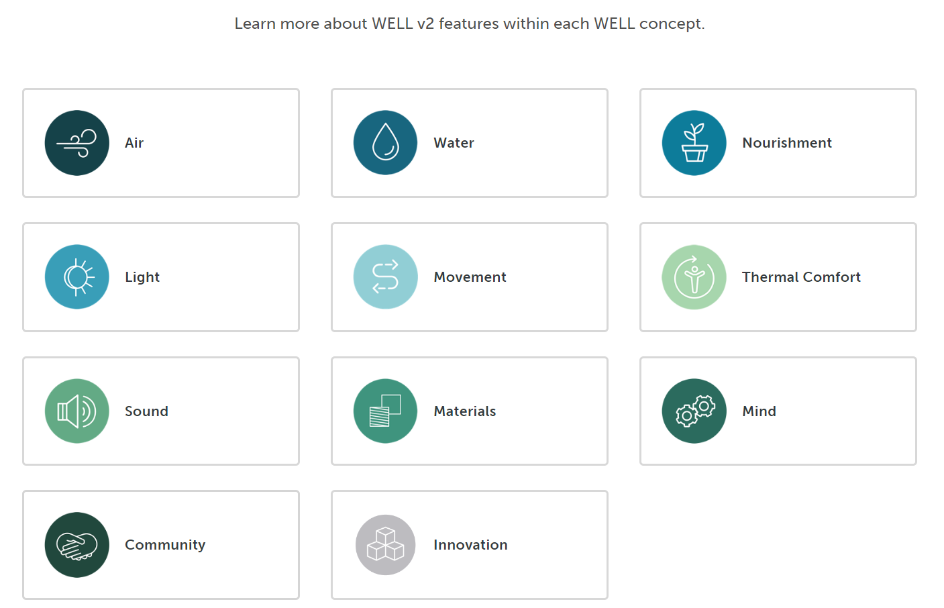
WELL Rating Tools

Slide 13


Slide 14
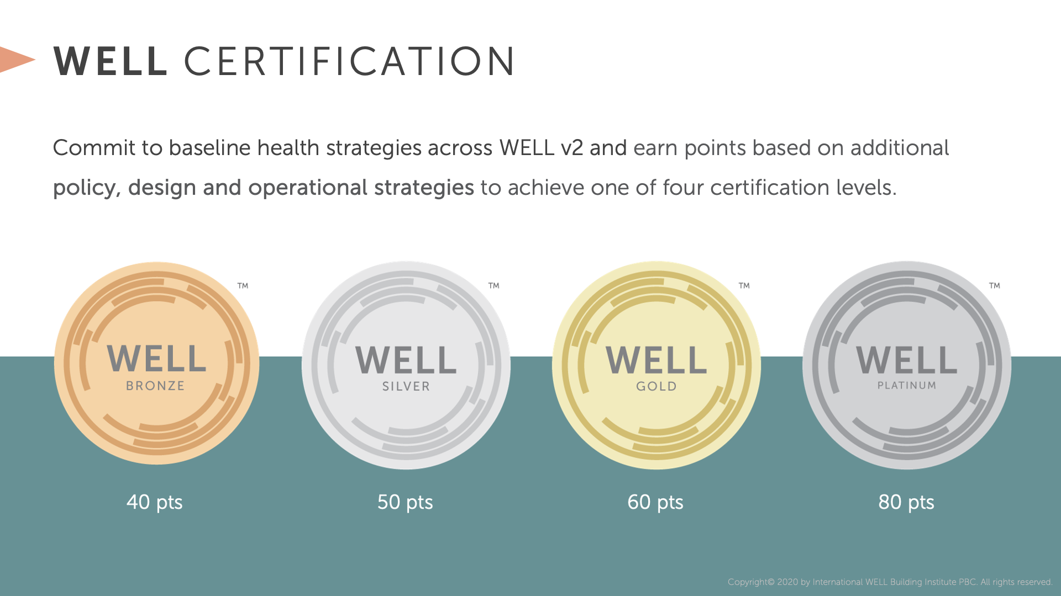

Slide 15
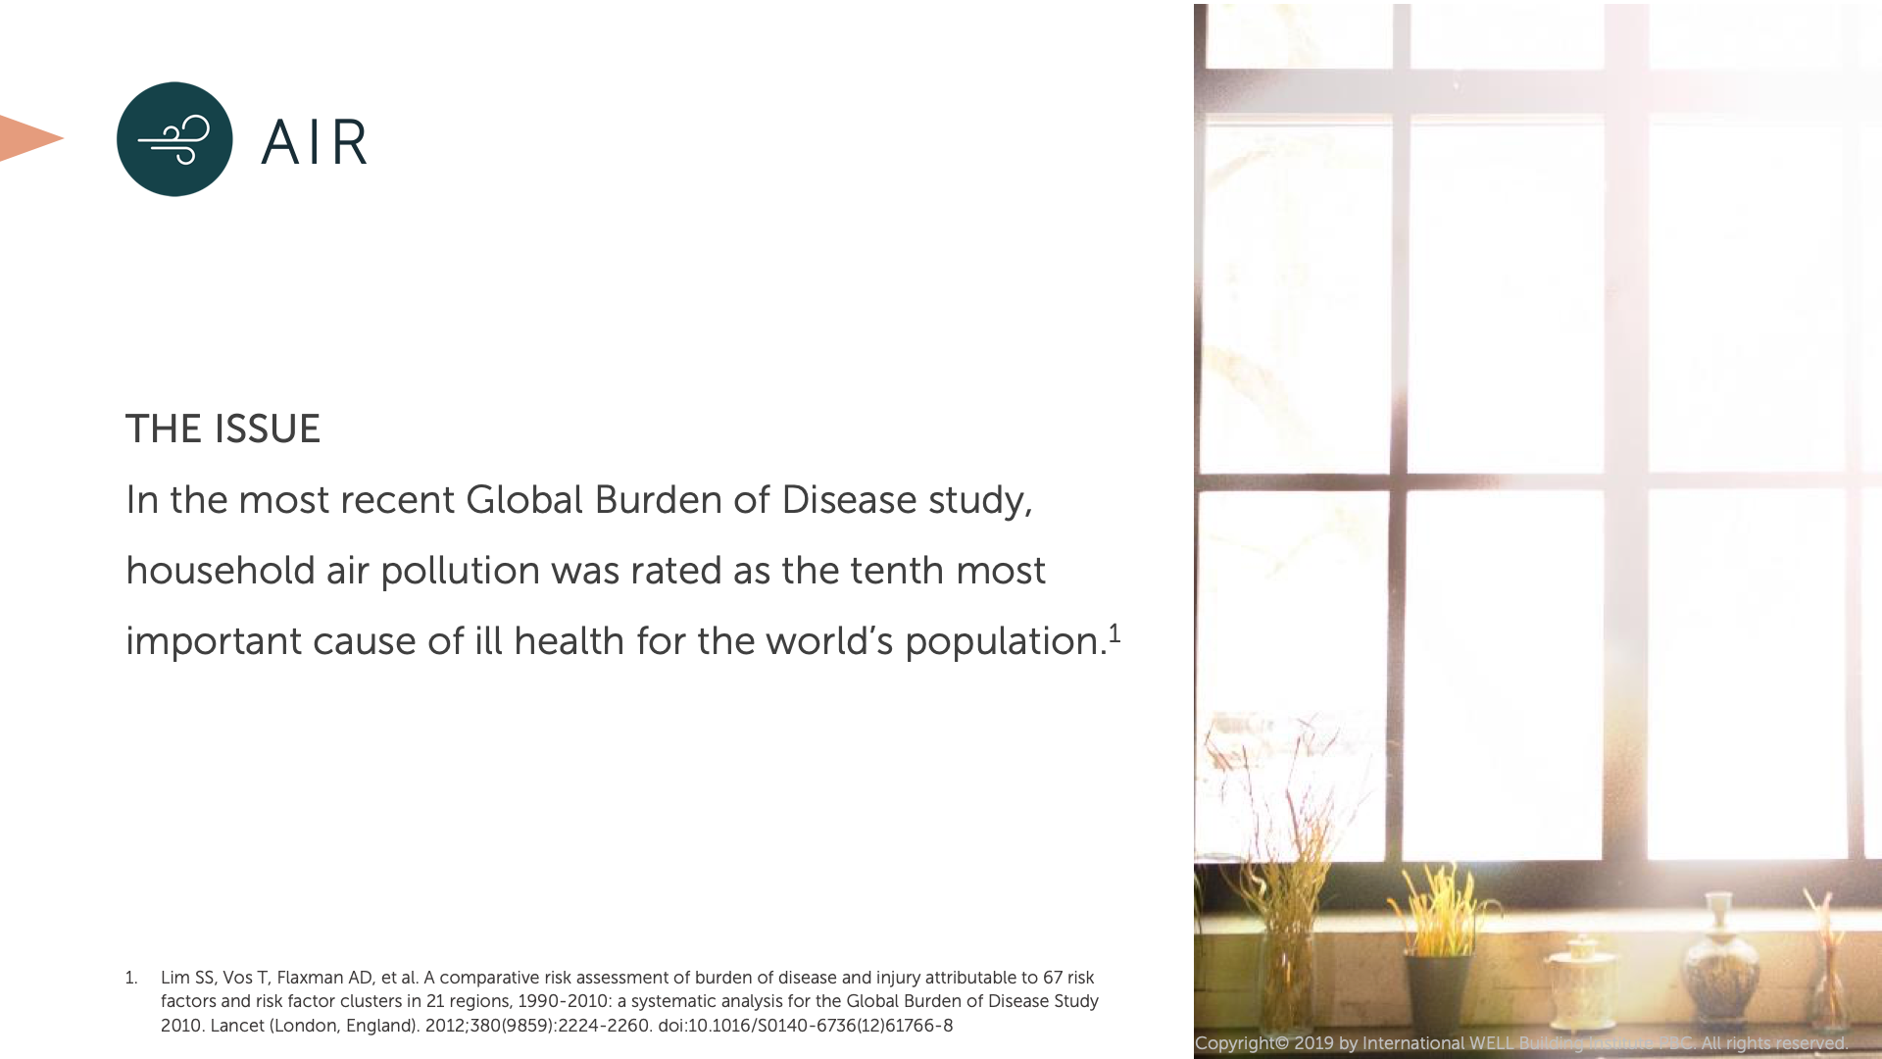

Slide 16


Slide 17


Slide 18


Slide 19


Slide 20


Slide 21


Slide 22


Slide 23


Slide 24


Slide 25


Slide 26


Slide 27


Slide 28
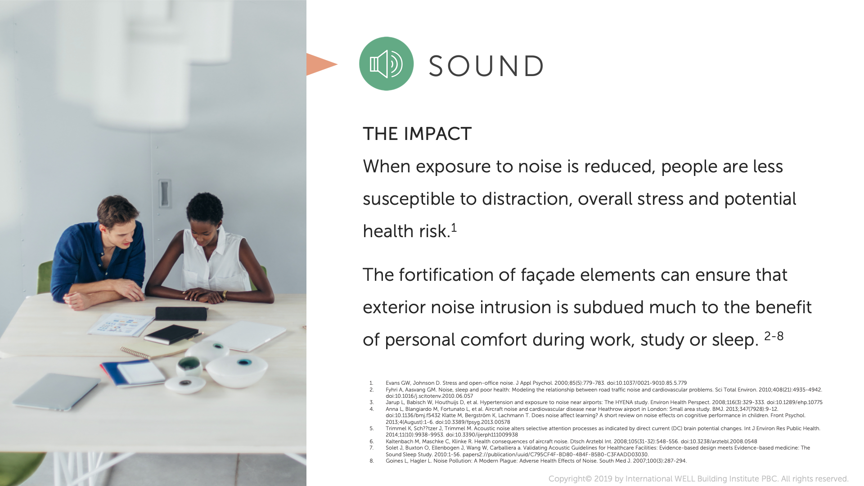

Slide 29


Slide 30


Slide 31


Slide 32


Slide 33


Slide 34


Slide 35

Subbies responsibility for WELL
    Understand the project WELL pathway and what it signs you up to deliver
    Understand rating tool requirements, specifically material compliance
    Ensure documentation collection systems are set up from the start
    Set up back-to-back contracts to ensure compliance by your subbies

Slide 36
Credits related to you – Products & Materials
  You must provide
    An upfront materials forecast and compliance evidence for Built approval prior to purchase and use on site
    Monthly material usage tracking sheets (with monthly claims) to ensure that non-compliant materials are kept within their allowance benchmarks
    A confirmation letter and close out evidence (certificates, invoices) once your scope is complete

Slide 37
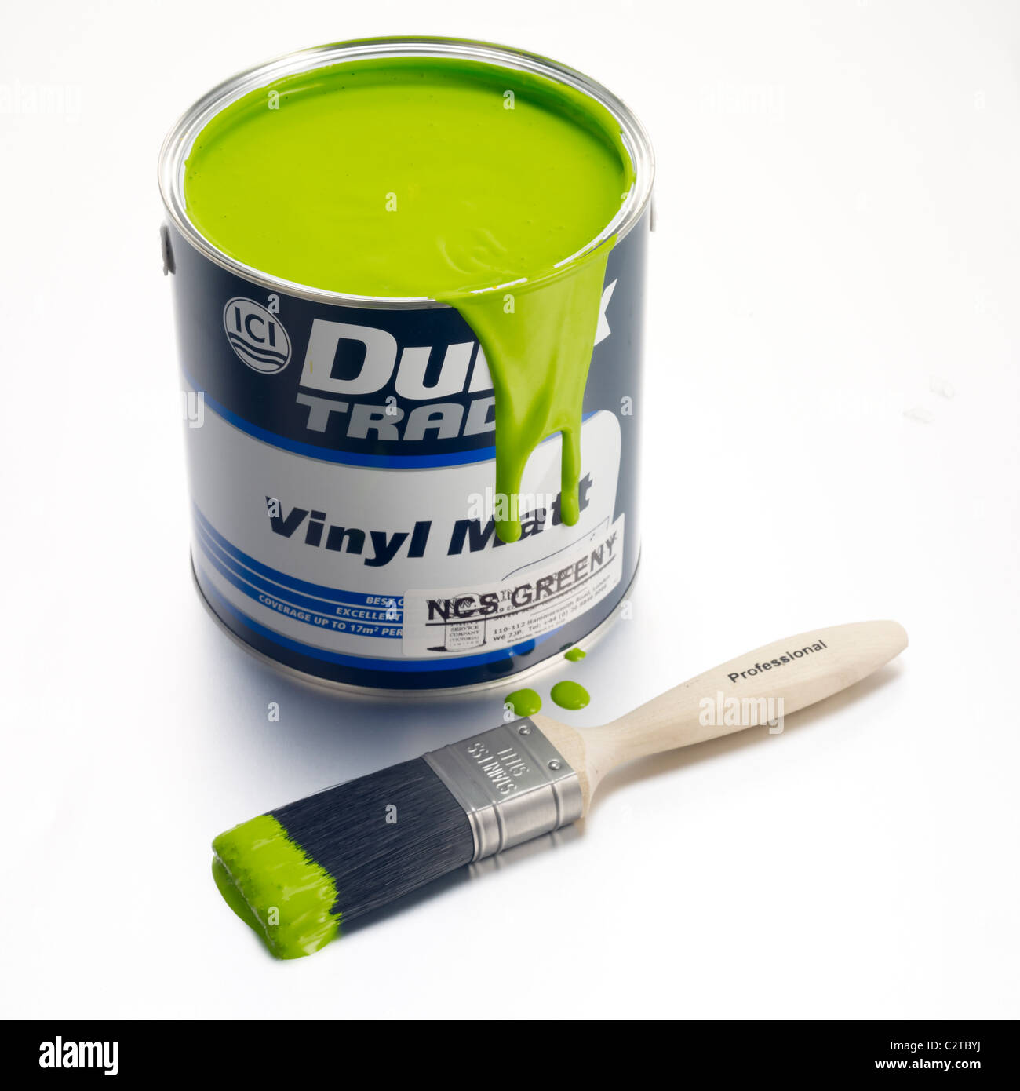
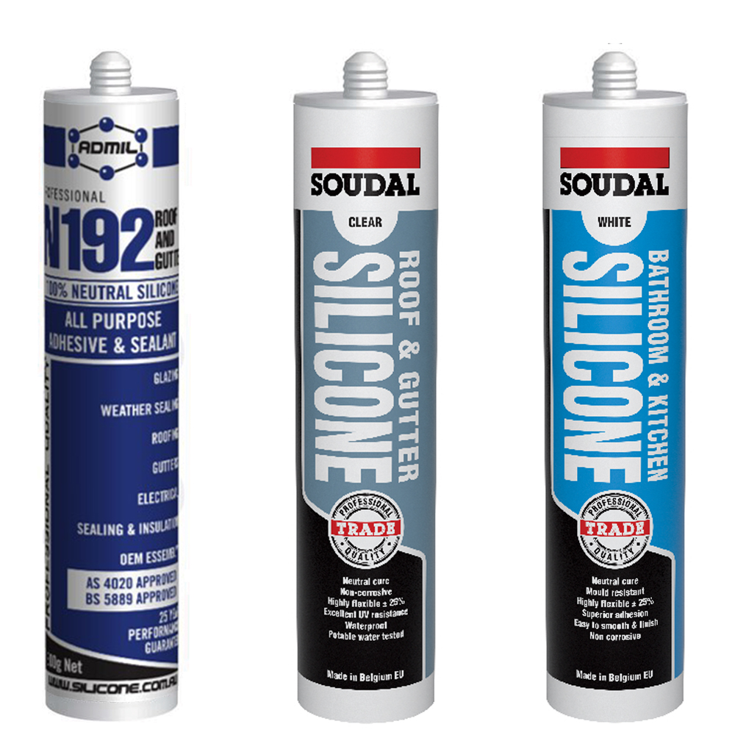

VOC restrictions
Sealants, Adhesives, Paints & Coatings
Compliant certification methods:
    All products must be tested to meet methods and thresholds established in 1 of the following standards/regulations for VOC content:
      SCAQMD Rule 1168 (Adhesives and Sealants, 2017).
      GB 33372-2020 (Adhesives).
      2019 CARB SCM for Architectural Coatings.7
      EU Ecolabel for indoor and outdoor paints and varnishes.
      HJ 2537-2014 (Paints).
      Any other standard listed in the ‘VOC content evaluation’ section of the ‘Low-Emitting Materials’ credit of the LEED v4.1 standard.8
    At least 75% of products are tested to meet testing methods and thresholds established in 1 of the following standards/regulations for VOC emissions:
      California Department of Public Health (CDPH) Standard Method v1.2.
      AgBB.9
      European Union LCI VOC thresholds10 following EN 16516-1:2017 testing methods

Slide 38
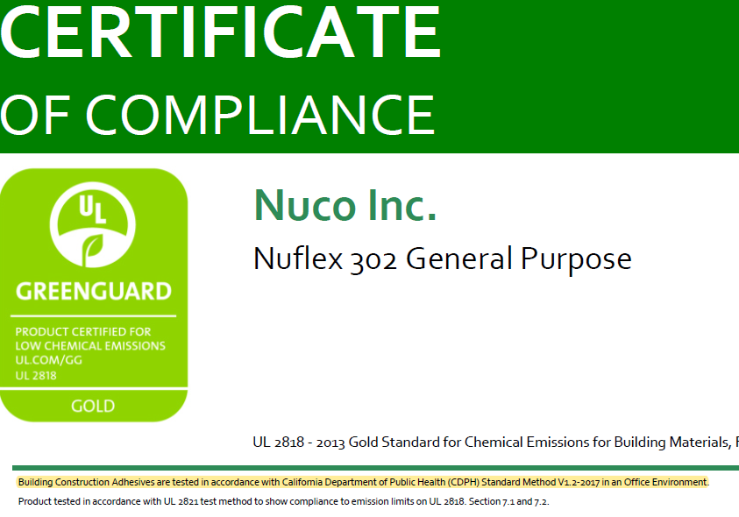
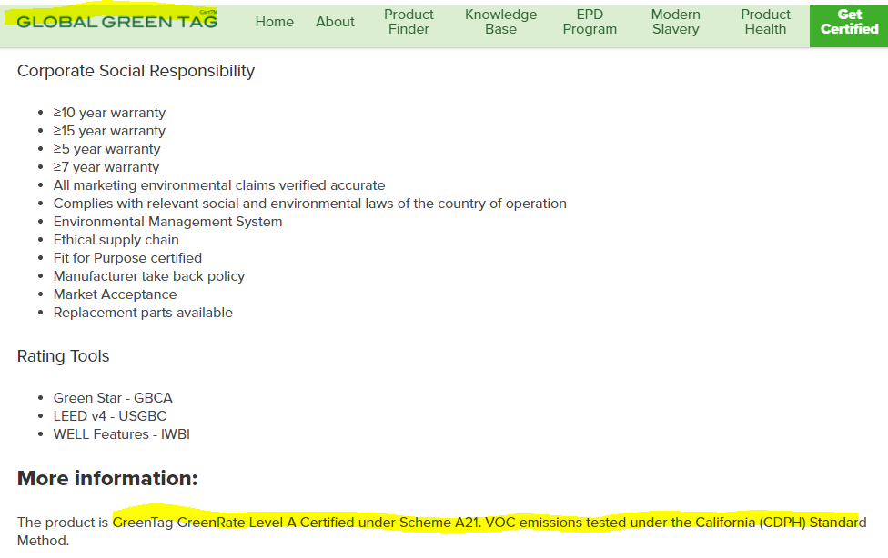
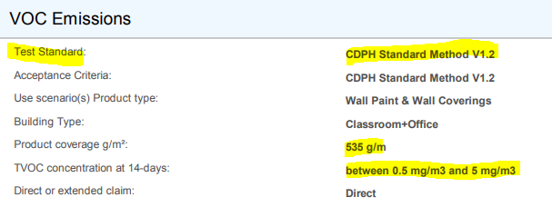
VOC restrictions
Sealants, Adhesives, Paints & Coatings

Slide 39
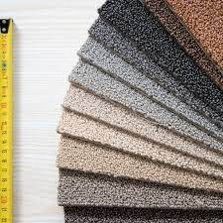

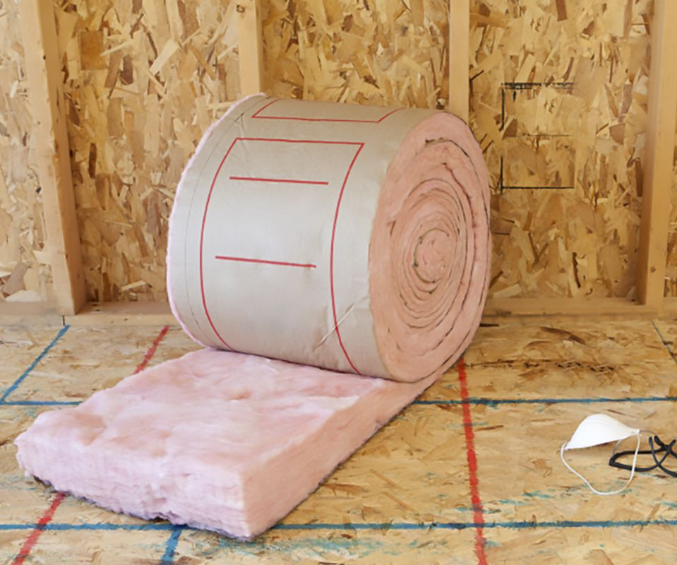
VOC emissions
Flooring, Furniture, Millwork, Insulation, Ceiling & Wall Panels
  Compliant certification methods
Products must be tested per methods and meet VOC emission thresholds established in 1 of the following:
    California Department of Public Health (CDPH) Standard Method v1.2
    AgBB.9
    European Union LCI VOC thresholds10 following EN 16516-1:2017 testing methods
    ANSI/BIFMA e3-2014, sections 7.6.1 or 7.6.2 (Furniture)

