Slide 1
Introduction to WELL
For Contractors

Slide 2
Learning Objectives
Understand the WELL Building Standard and the value of the WELL certification
Identify factors which influence human health and wellbeing
Gain awareness of the current WELL rating tools and how they impact your work
Learn how to determine compliant products and materials through examples

Slide 5
Why WELL?
A WELL Certified project has the potential to add measurable value to the health, well-being, productivity, and happiness of building occupants
By placing people at the heart of design, construction, operations and development decisions, we have the ability to add value to real estate assets, generate savings in personnel costs, and enhance the human experience, health and well-being
Prioritizing WELL also provides the opportunity to stand at the forefront of innovation in the sustainable and healthy building movement
Physical workplace is one of the top 3 factors affecting performance and job satisfaction
Personnel costs significantly outweigh the costs for design and construction and maintenance and operations

Slide 6
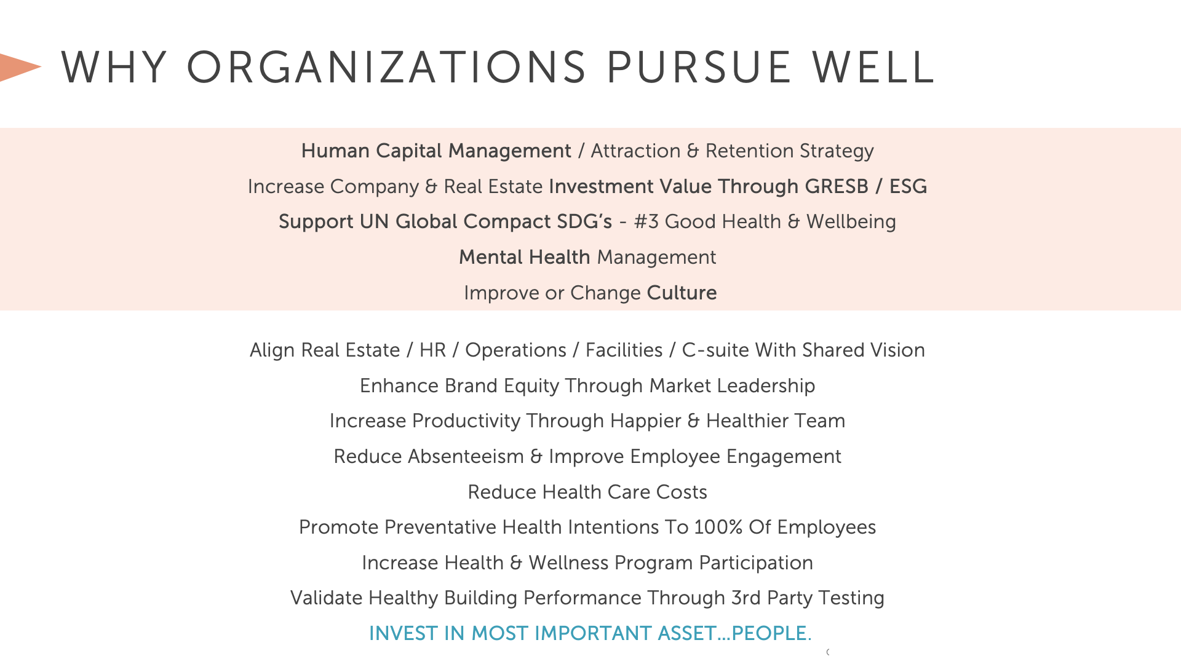

Slide 8
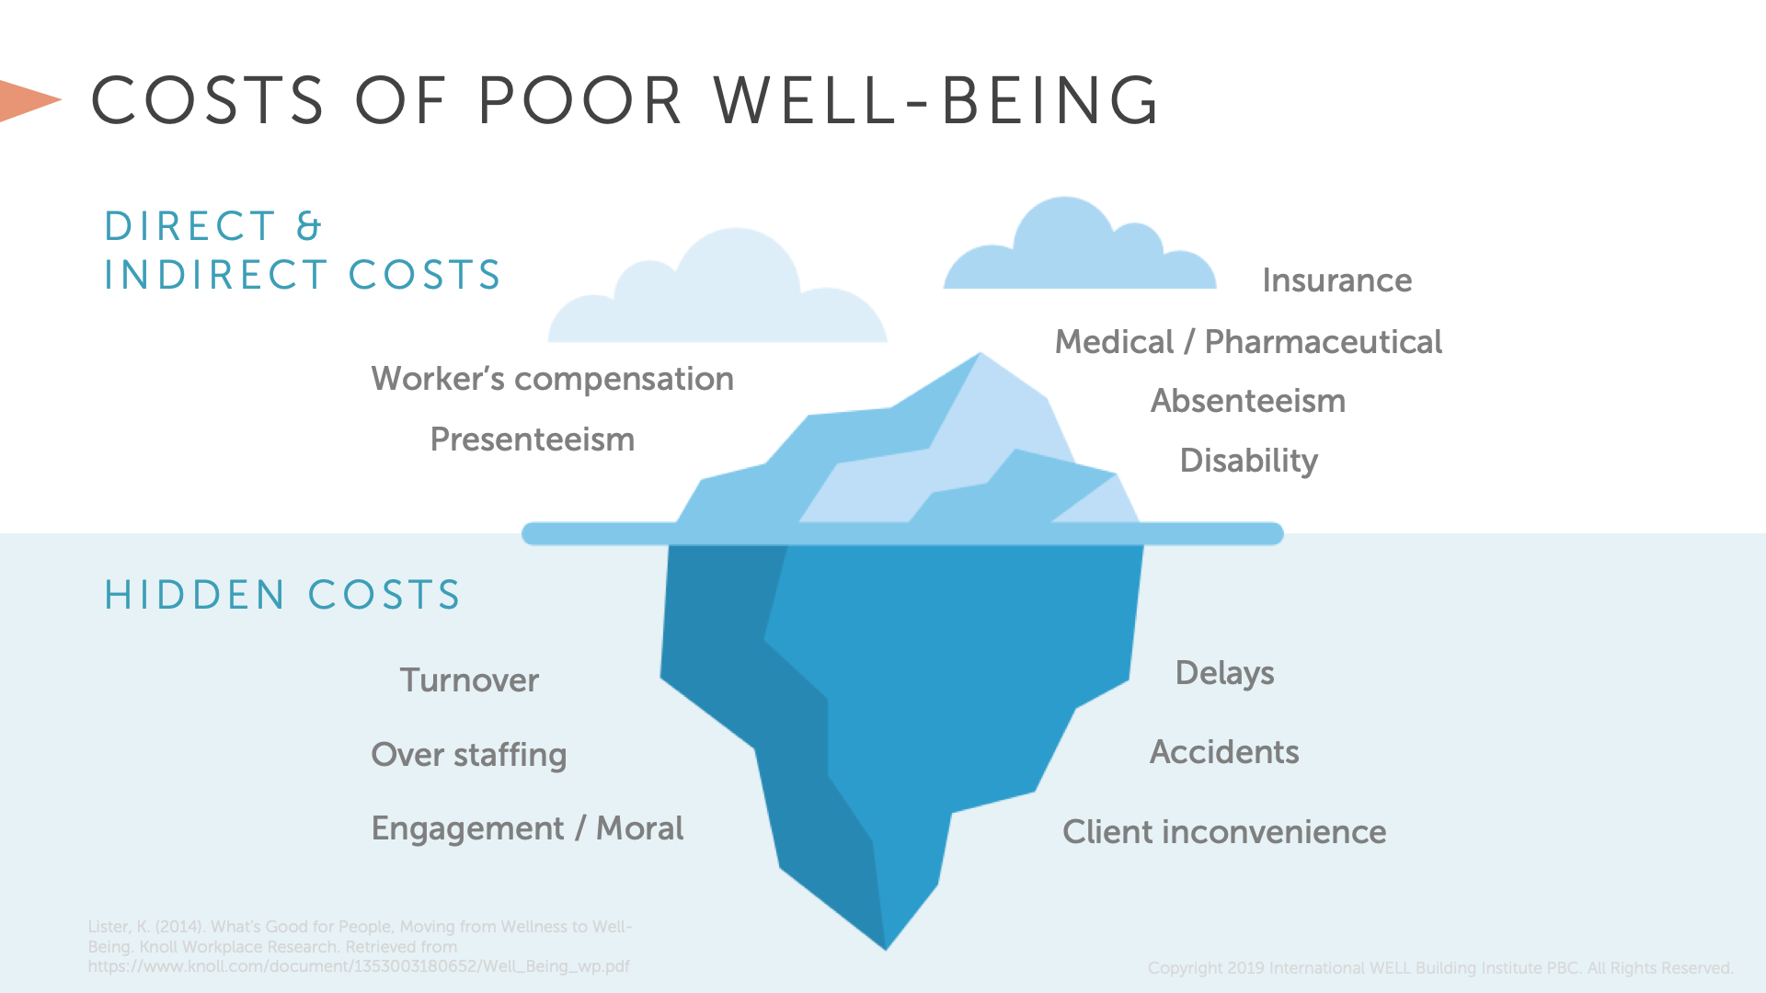

Slide 10
Australian Government Comcare, 2016. Benefits to Business: The Evidence for Investing in Worker Health and Wellbeing. https://www.comcare.gov.au/__data/assets/pdf_file/0006/99303/Benefits_to_business_the_evidence_for_investing_in_worker_health_and_wellbeing_PDF,_89.4_KB.pdf Accessed November 1, 2017.
Copyright© 2017 by International WELL Building Institute PBC. All rights reserved.
Economic return of worksite health promotion programs found, on average, programs save AU$5.81 for every AU$1 invested in employee health and wellbeing.¹

Slide 12
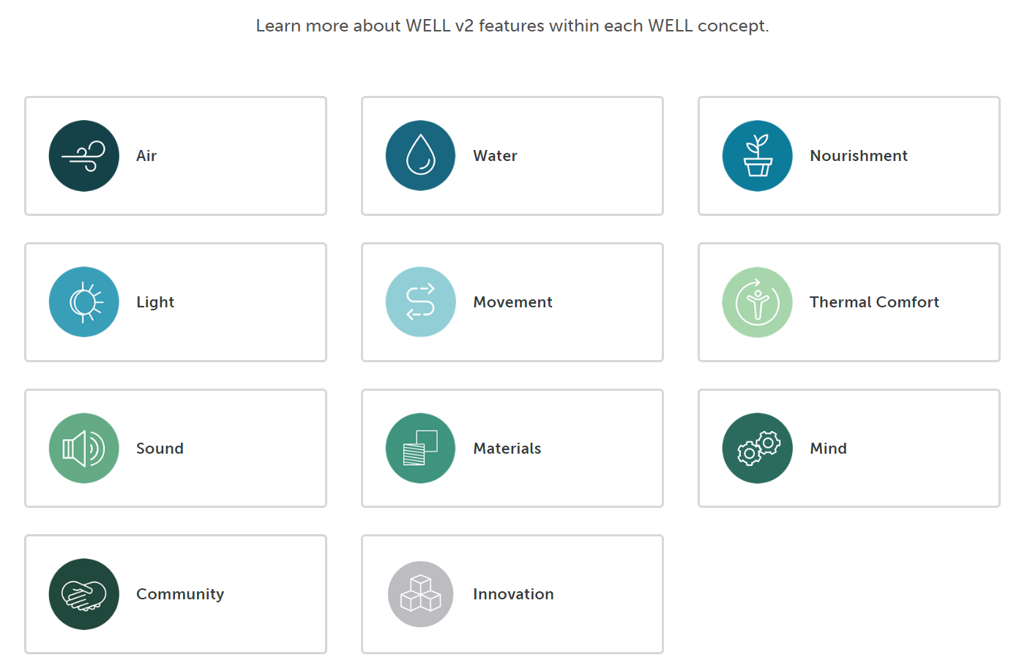
WELL Rating Tools

Slide 35
Subbies responsibility for WELL
Understand the project WELL pathway and what it signs you up to deliver
Understand rating tool requirements, specifically material compliance
Ensure documentation collection systems are set up from the start
Set up back-to-back contracts to ensure compliance by your subbies

Slide 36
Credits related to you – Products & Materials
You must provide
An upfront materials forecast and compliance evidence for Built approval prior to purchase and use on site
Monthly material usage tracking sheets (with monthly claims) to ensure that non-compliant materials are kept within their allowance benchmarks
A confirmation letter and close out evidence (certificates, invoices) once your scope is complete

Slide 37
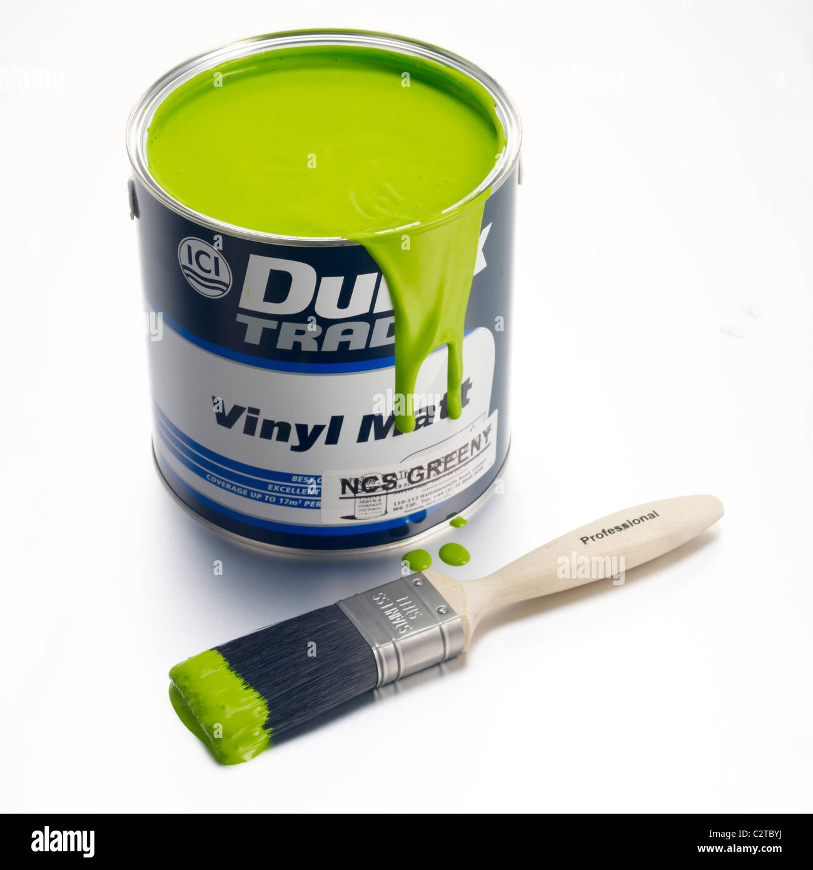
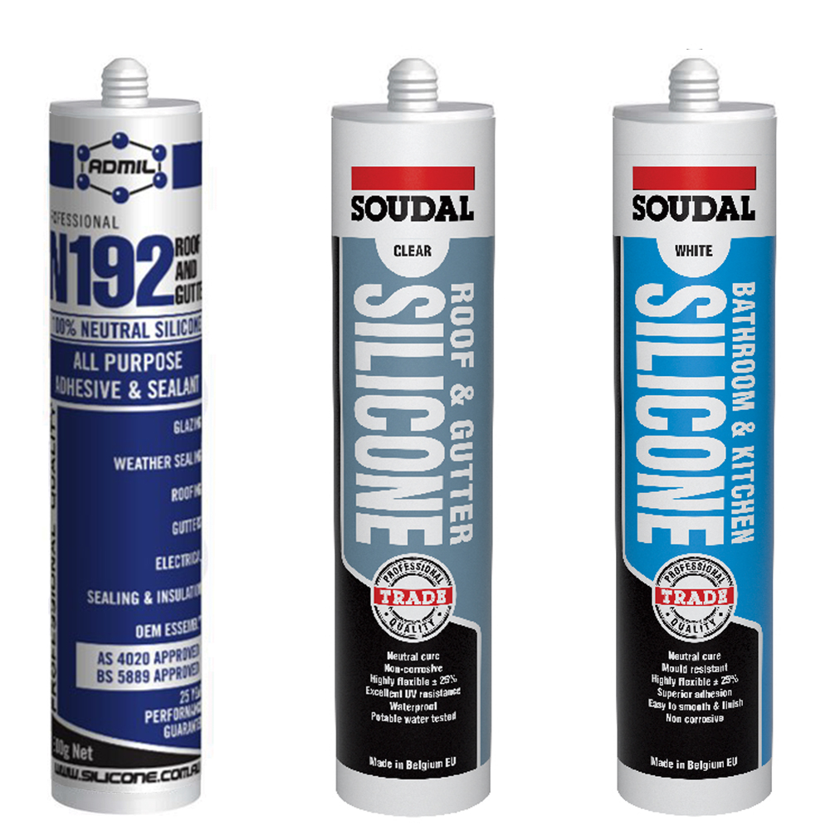
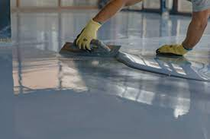
VOC restrictions
Sealants, Adhesives, Paints & Coatings
Compliant certification methods:
All products must be tested to meet methods and thresholds established in 1 of the following standards/regulations for VOC content:
SCAQMD Rule 1168 (Adhesives and Sealants, 2017).
GB 33372-2020 (Adhesives).
2019 CARB SCM for Architectural Coatings.7
EU Ecolabel for indoor and outdoor paints and varnishes.
HJ 2537-2014 (Paints).
Any other standard listed in the ‘VOC content evaluation’ section of the ‘Low-Emitting Materials’ credit of the LEED v4.1 standard.8
At least 75% of products are tested to meet testing methods and thresholds established in 1 of the following standards/regulations for VOC emissions:
California Department of Public Health (CDPH) Standard Method v1.2.
AgBB.9
European Union LCI VOC thresholds10 following EN 16516-1:2017 testing methods

Slide 38
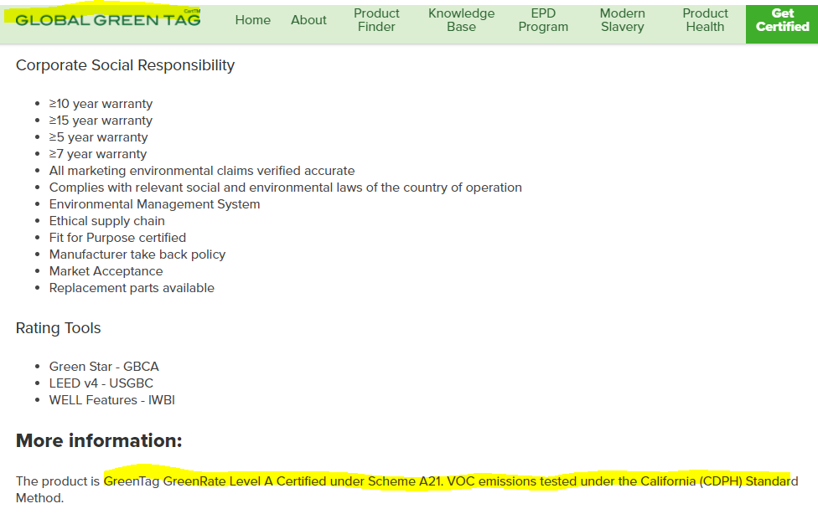
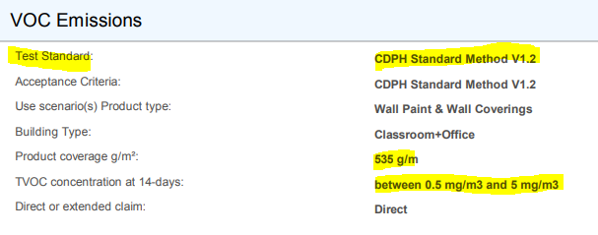
VOC restrictions
Sealants, Adhesives, Paints & Coatings

Slide 39
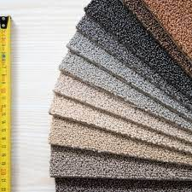
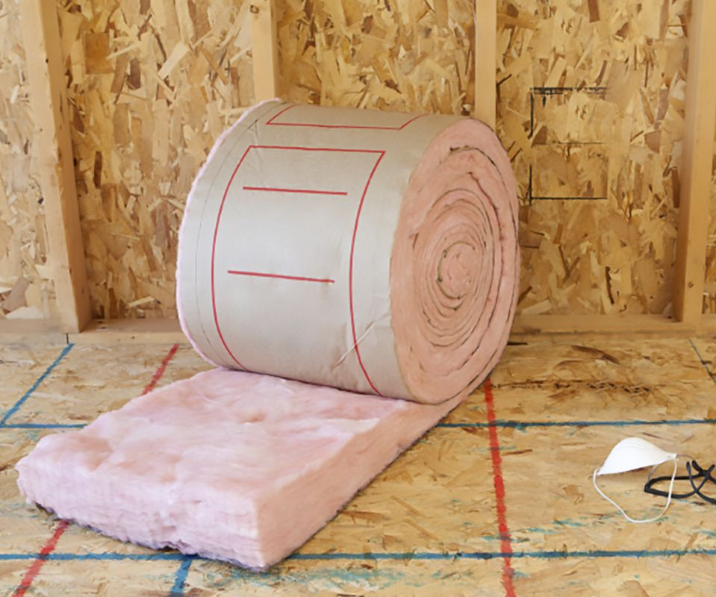
VOC emissions
Flooring, Furniture, Millwork, Insulation, Ceiling & Wall Panels
Compliant certification methods
Products must be tested per methods and meet VOC emission thresholds established in 1 of the following:
California Department of Public Health (CDPH) Standard Method v1.2
AgBB.9
European Union LCI VOC thresholds10 following EN 16516-1:2017 testing methods
ANSI/BIFMA e3-2014, sections 7.6.1 or 7.6.2 (Furniture)

Slide 40
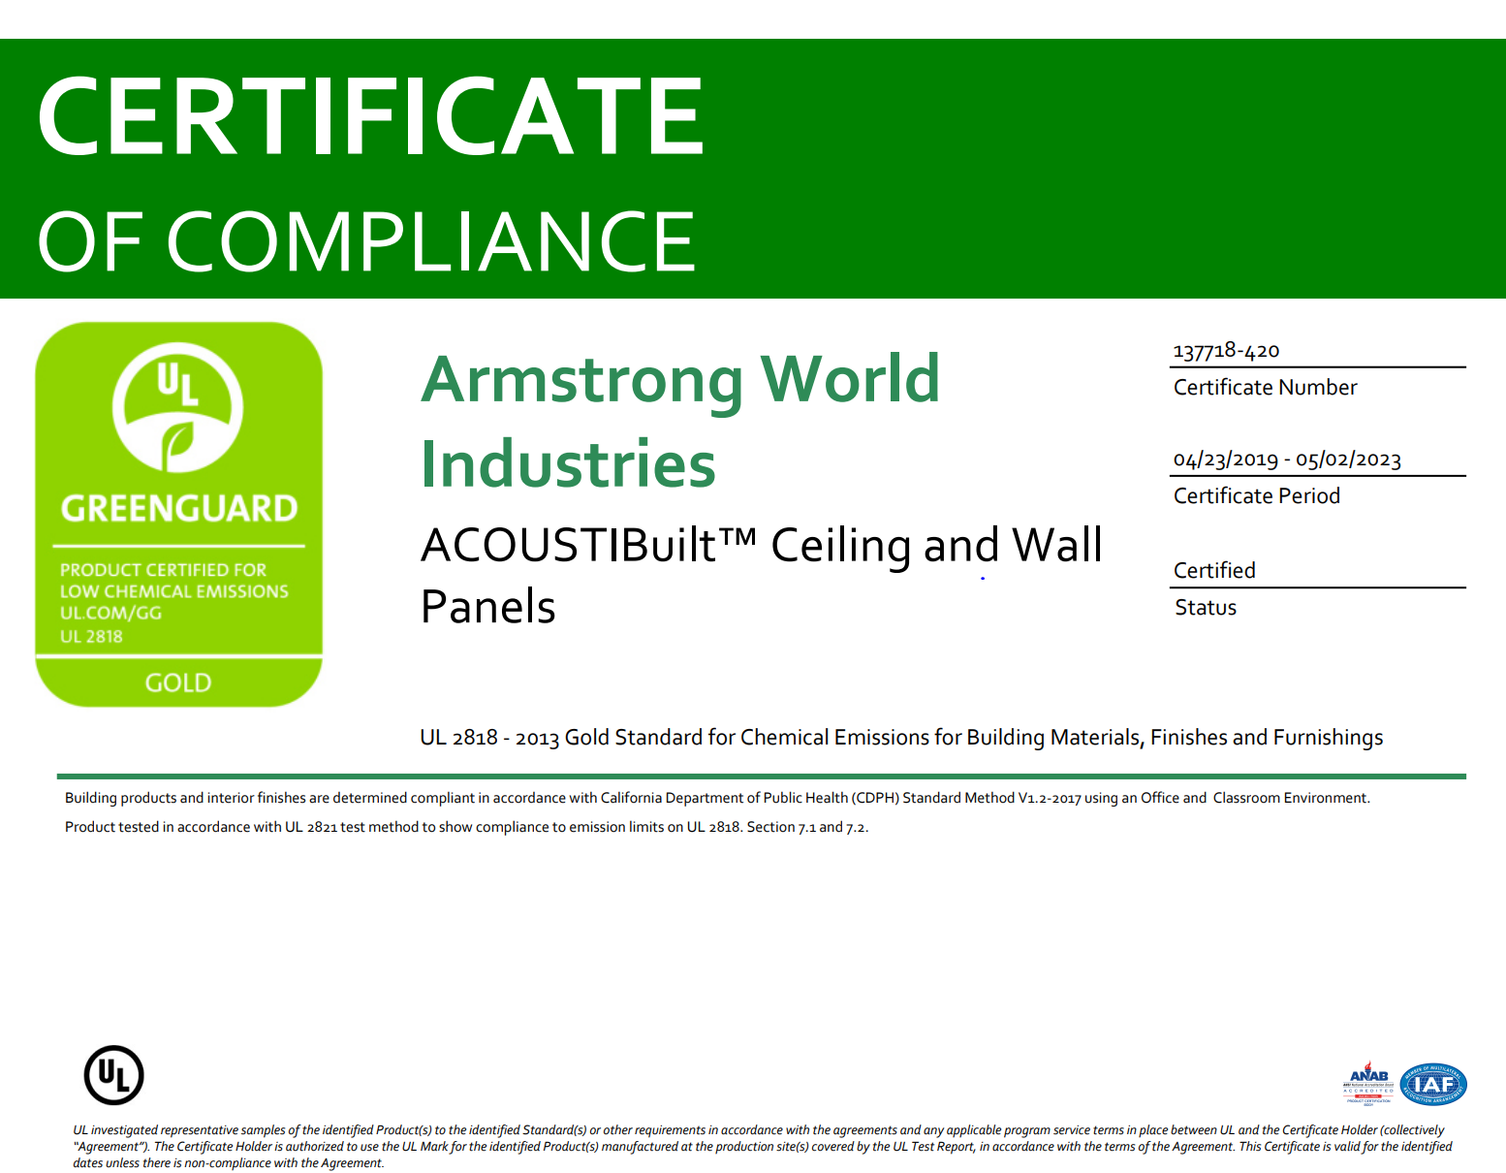
VOC restrictions
Flooring, Furniture, Millwork, Fixtures, Insulation, Ceiling & Wall Panels

